Slide 1

Maths at Halstow
Information Evening for Parents and Carers
Reception to Year 6

Slide 2
Mastery is..
Achievable for all.
Deep and sustainable learning.
The ability to build on something that has already been sufficiently mastered.
The ability to reason about a concept and make connections.
Conceptual and procedural fluency.

Slide 3
Teaching for Mastery
The belief that all pupils can achieve.
Keeping the class working together so that all can access and master mathematics.
Development of deep mathematical understanding.
Development of both factual/procedural and conceptual fluency.
Longer time on key topics, providing time to go deeper and embed learning.

Slide 4
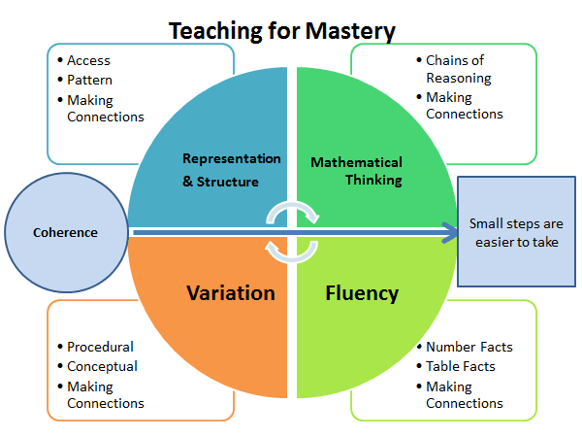
Notes:
RT

Slide 5
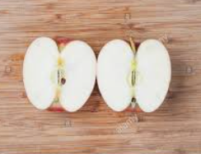

5 Big Ideas
Coherence
Representation and structure
Mathematical thinking
Fluency
Variation
Quick and efficient recall of facts and methods in different contexts
Varying how the concept is being taught to make sure children’s understanding is robust.
Taking small, logical steps so children build a secure understanding.
Clear visual representations of the maths
Teaching ideas deeply so children can reason confidently
CPA
Concrete
Pictorial
Abstract
$$\frac{1}{2}$$

Slide 6
Coherence
Structure of a Mastery Lesson
Starter
Guided Practise
Intelligent Practise
Plenary
- Revisit
- Review
- Address misconceptions
- Deepen with reasoning
I do
Modelling
We do
Guided practice
You do
Independent task
Addressing misconceptions / reasoning and problem solving

Slide 7
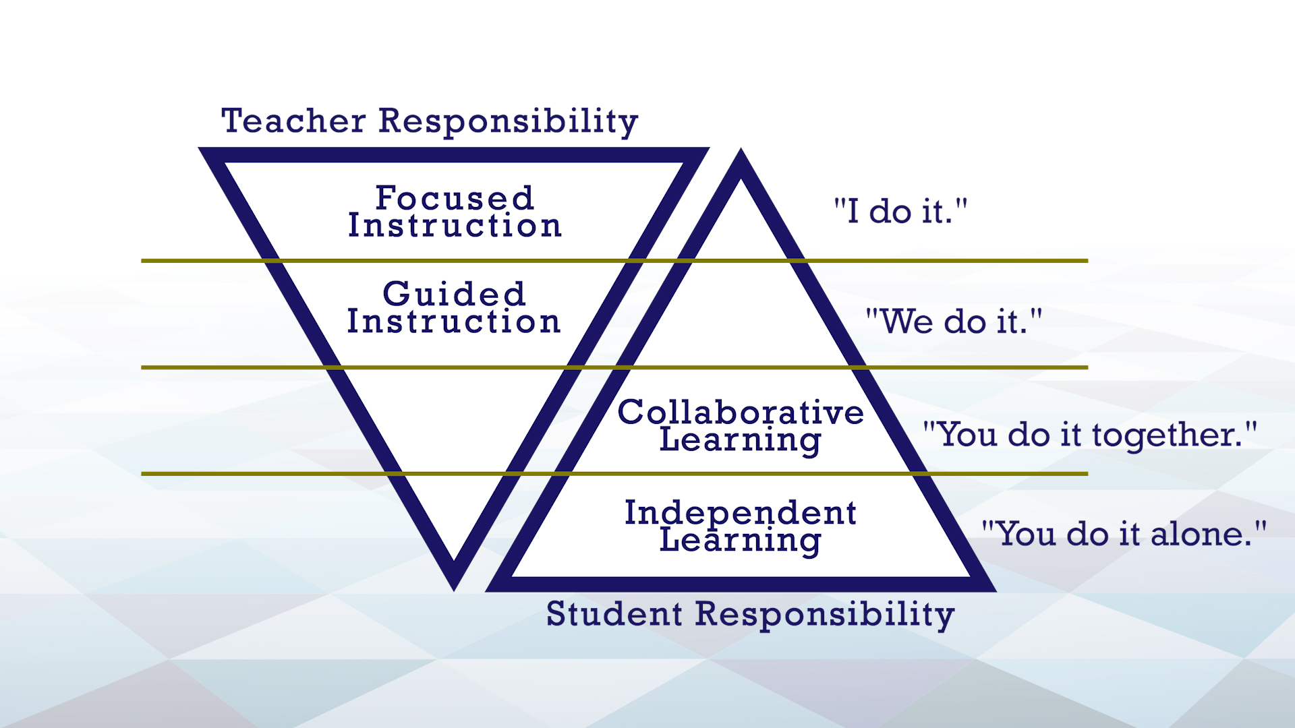
I do. We do. You do

Slide 8
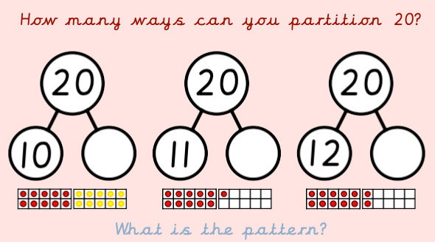
Starter
Revisit prior learning where you feel children may not have 100% secured their knowledge
Review learning from previous weeks, terms and years to help children’s knowledge stick
Address specific misconception
Deepen learning through reasoning and problem solving from yesterday's learning allowing access to more children
Revisiting partitioning / number bonds to 20

Slide 9
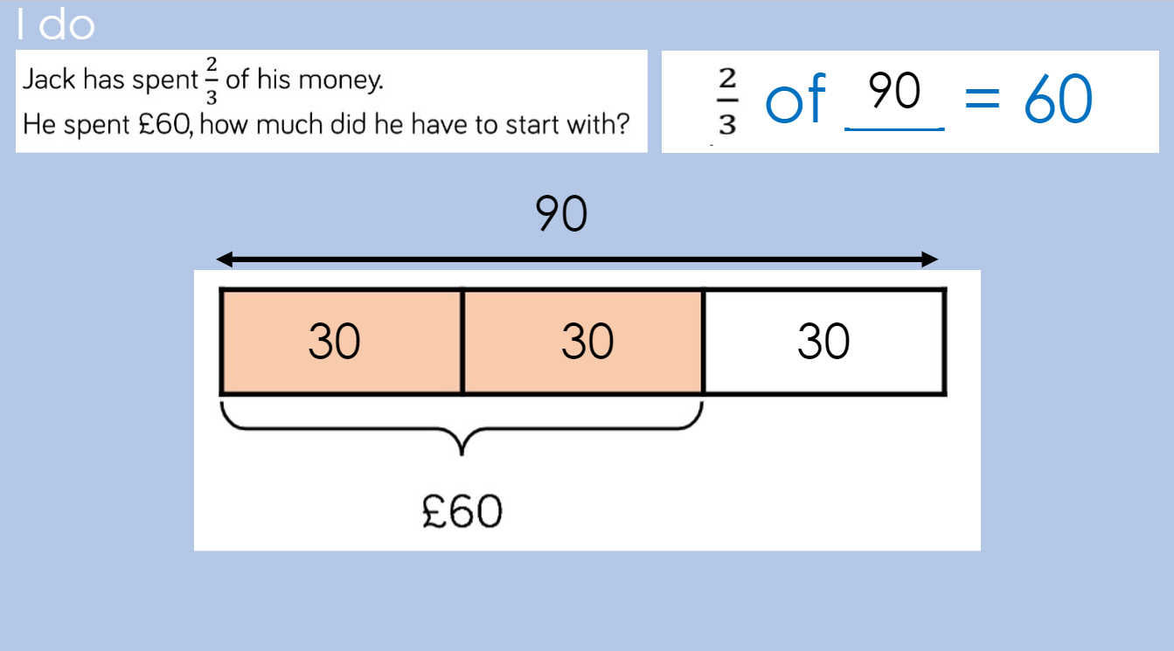
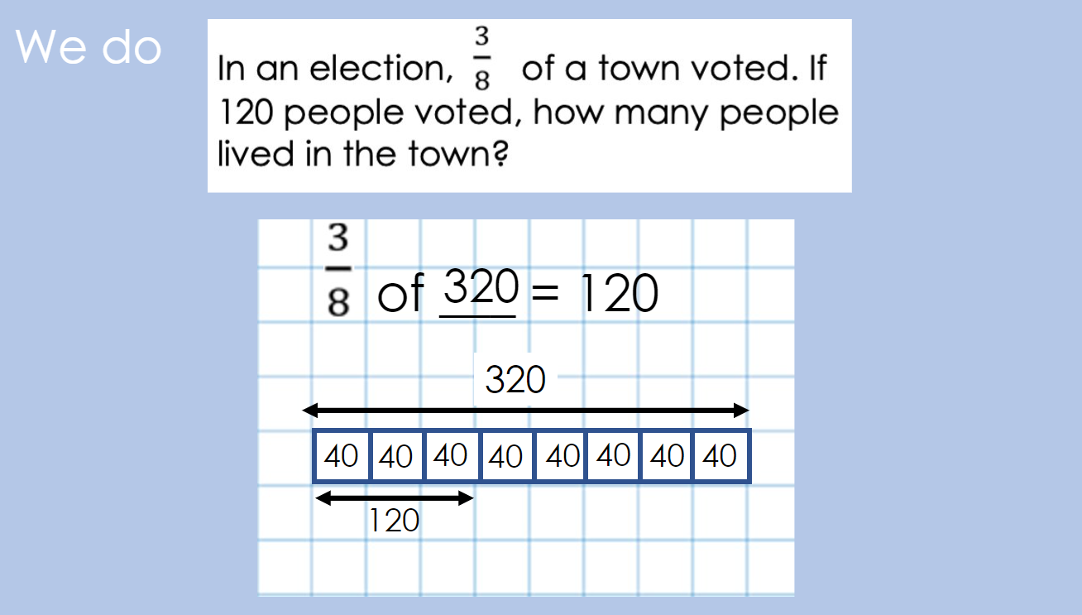
Guided Practice
I DO, WE DO
Quality teacher modelling first (I do)
Use of clear, precise vocabulary
Repeated stem sentences
CPA approach
Children given the opportunity to try out the maths in steps, with teacher and peer support

Slide 10
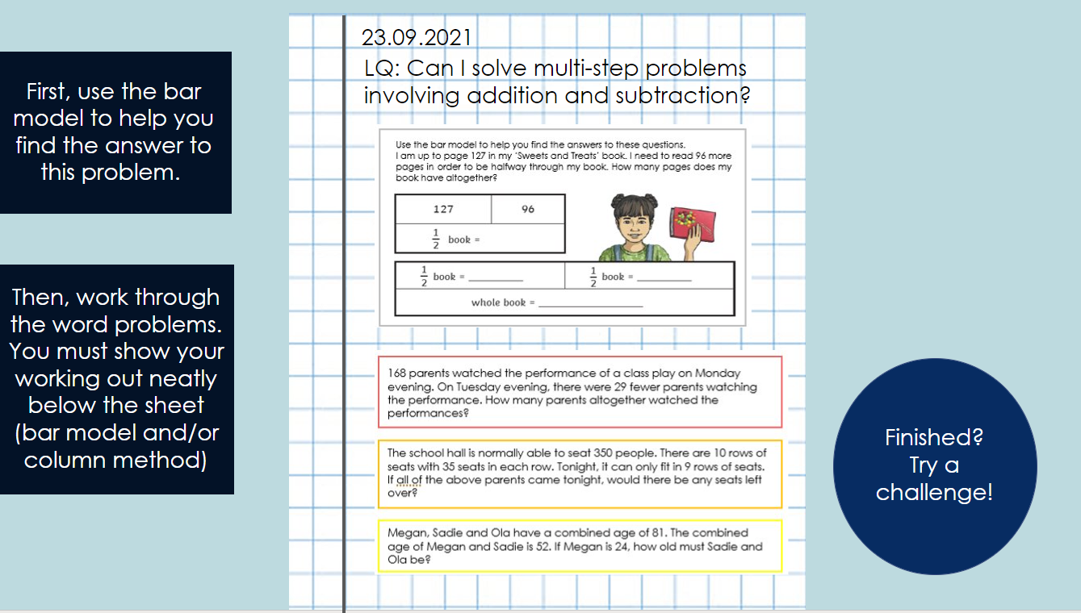
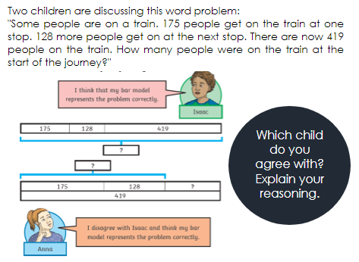
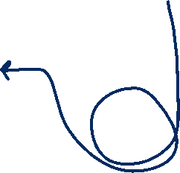
Intelligent Practice
YOU DO
- Independent, age-related task
- Next steps - variation extensions, open- ended reasoning and problem solving
to deepen understanding
Finished? Deepen your learning with some reasoning!

Slide 11
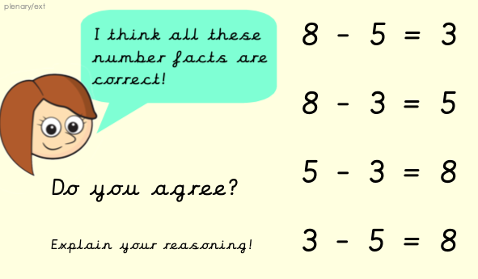
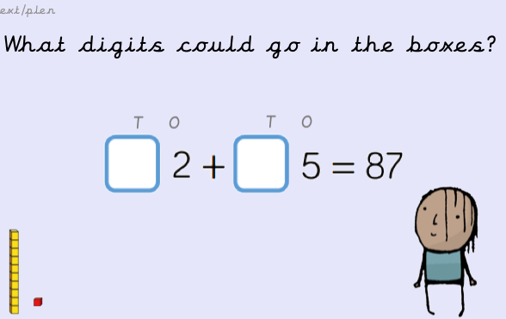
Plenary
Deepen learning through whole-class reasoning and problem solving.
Model strategies either by doing the above, or by children marking their learning with teacher modelling solutions
Children have opportunities to articulate their own strategies for problem solving
Address misconceptions
Discuss next steps

Slide 12


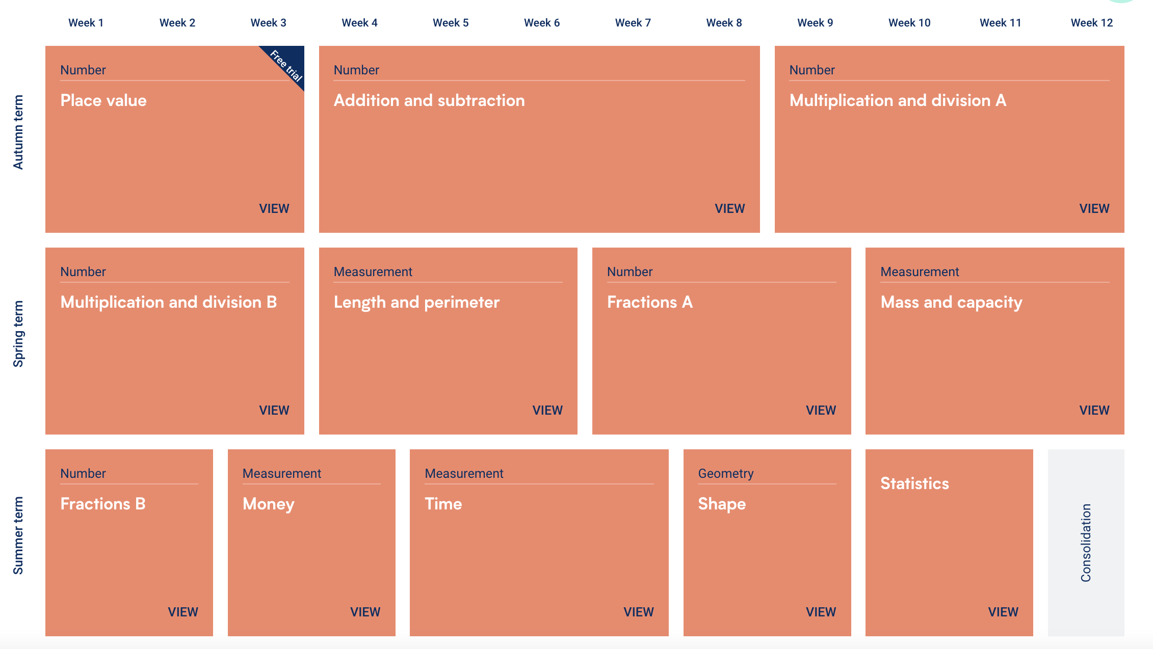

Slide 13
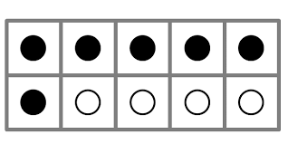
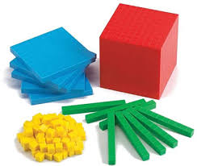
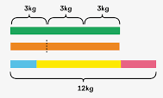
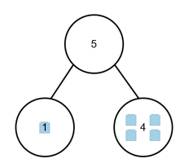
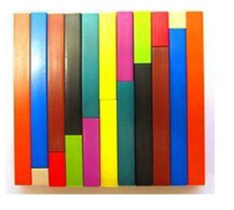
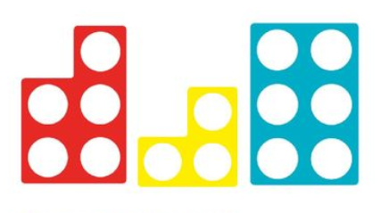
Representation and Structure
Representations expose the structure of the calculation or problem
Notes:
RT

Slide 14
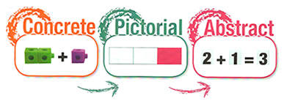
Representation and structure:
Concrete, pictorial and abstract representations
‘Children aged seven to ten years old work in primarily concrete ways and the abstract notions of mathematics may only be accessible to them through the embodiment of practical resources.’
Piaget (1951)
Notes:
RT

Slide 15
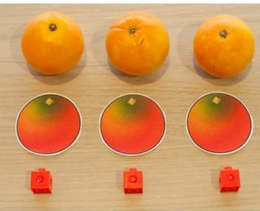
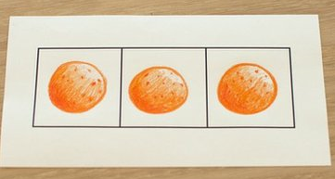
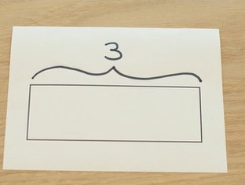
Representation and structure:
Concrete, pictorial and abstract representations
Literal to iconic representation
Drawing boxes (bar) around
Appreciating the
bar as the whole
(stopping counting
in ones )
Notes:
RT

Slide 16
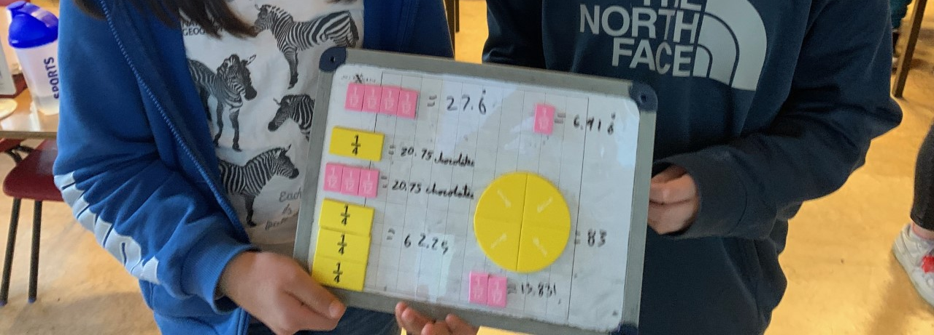
Year 6
CPA representation is just as vital a tool to use when tackling really challenging maths

Slide 17
Variation
What is variation?
'Influencing the way children think’
Conceptual variation is how the teacher presents a concept being taught, often in more than one way, to draw attention to a specific aspect and to deepen understanding.
Procedural Variation is about the sequence of activities, paying attention to what is being kept the same and what changes. This is to draw attention mathematical relationships and structure.
Notes:
RT

Slide 18
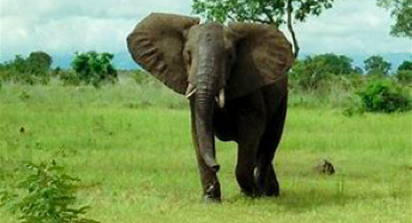
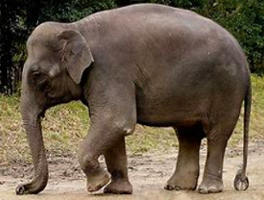
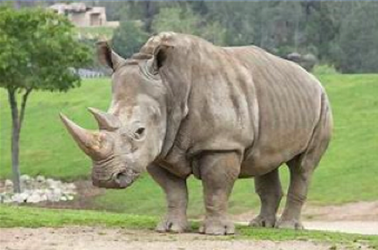


What is an elephant? What is not an elephant?

Slide 19

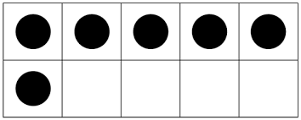
The central idea of variation is to highlight the essential features of concepts through varying the non- essential features.
'Gu, Huang & Marton 2004'
Conceptual variation - different representations of the same idea strengthens our understanding of what it is.
What would a child understand about the 'sixness’ of six through only being exposed to Numicon?
Procedural Variation is choosing to vary one aspect to expose a mathematical structure or connection.
Is there a way to structure learning of bonds 6 in a way that encourages children to think mathematically, see patterns and make connections?
Notes:
RT

Slide 20
What does it mean to be a fluent mathematician?
Fluency
I know how to do it.
It becomes automatic and I don't need to think about it- for example driving a car.
I'm good at doing it.
I can show someone else how to do it.

Slide 21
In a Maths mastery context, fluency is achieved when children are so familiar with a concept, they can solve problems relating to it however the question is asked.
The understanding of the concept is so secure that they can do it automatically, and their working memory can be freed up.
Notes:
RT

Slide 22
Fluency encompasses….
Efficiency
Using an appropriate strategy or algorithm with speed. This implies that the student does not get bogged down in too many steps or lose track of the logic of the strategy
Accuracy
Finding correct solutions. This depends on several aspects of the problem-solving process, among them careful recording, knowledge of number facts and other important number relationships
Flexibility
Adapting strategy and transferring across contexts. It requires the knowledge of more than one approach to solving a particular kind of problem, such as 2-digit multiplication. Student needs to be flexible in order to choose appropriate strategy for the problem at hand and also able to use another strategy to check their problem.

Slide 23
Mastering Number EYFS and KS1
Systematic and structured scheme of work
based in deepening understanding of number and quantity.
It builds on our innate ability to process quantities visually
with graphics that expose mathematical structures.
This programme brings focus to teaching early calculation
that phonics programmes bring to teaching decoding.

Slide 24

Number Sense
Daily ten-minute fluency sessions starting in January of Year 3
The programme develops recall of 36 core multiplication facts. Fluency in these facts provides the foundation for all written and mental multiplication and division.
New facts are introduced and taught visually through the conceptual lessons, and aurally through the chanting of verbal sound patterns.
Facts are learned to fluency through daily practice sessions with scores tracked daily and targeted support provided where needed.
The programme is informed by research into the mathematical development of young children, particularly how children achieve automacity in multiplication facts.

Slide 25
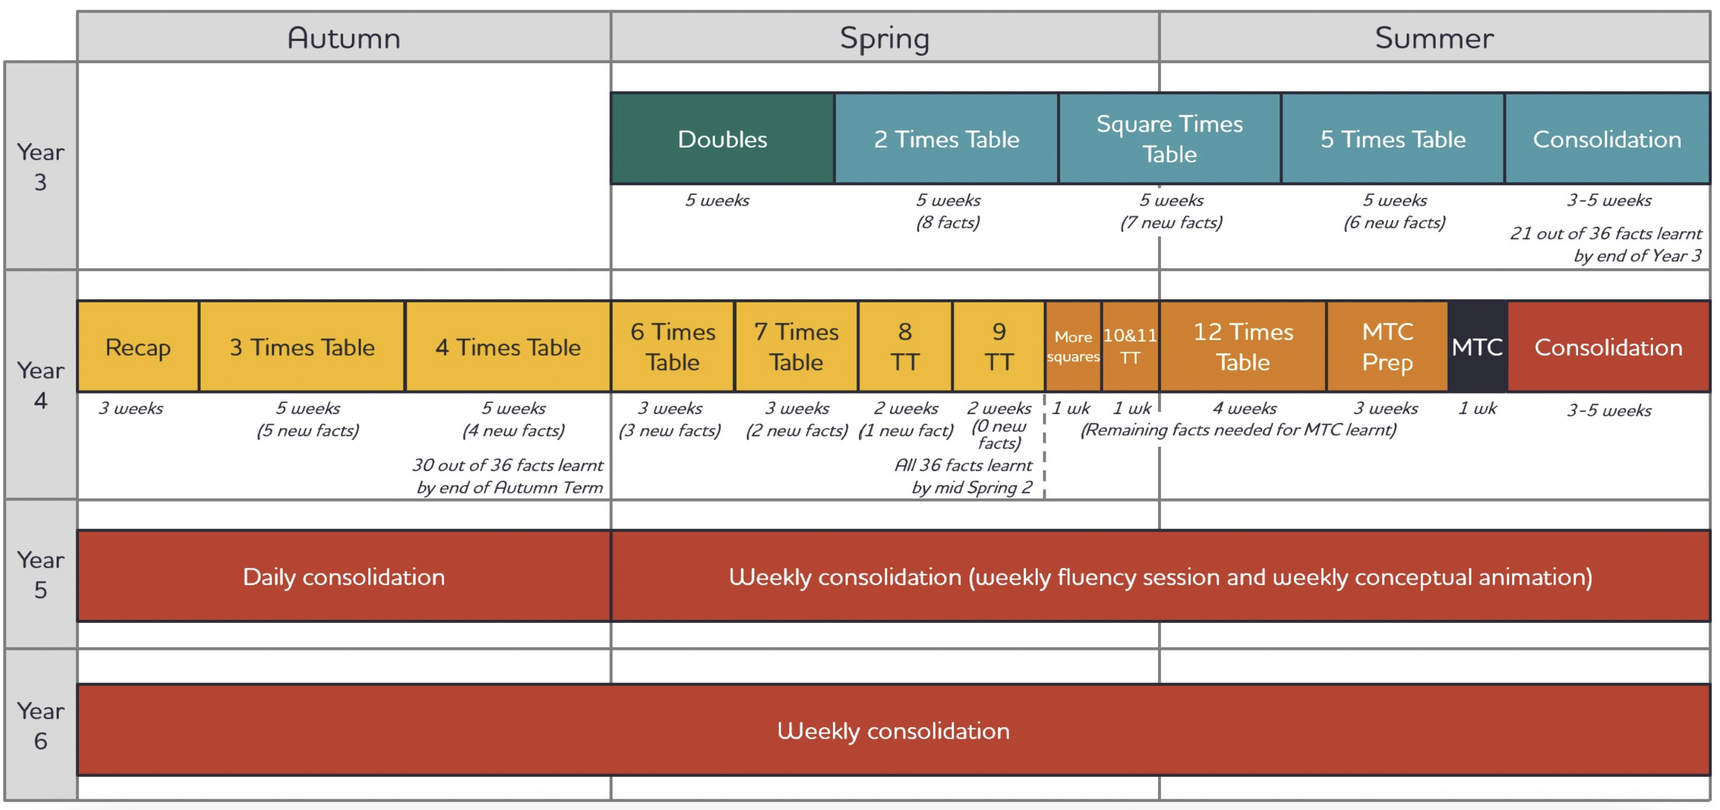
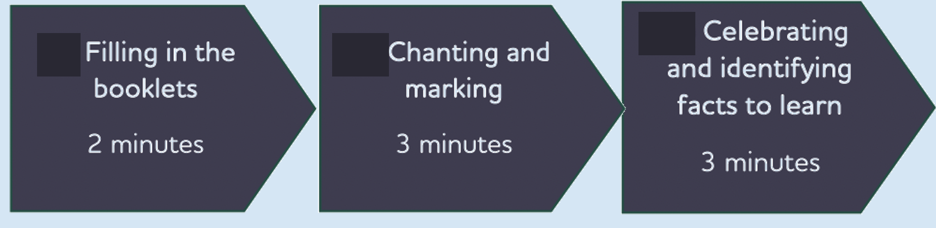

Slide 26
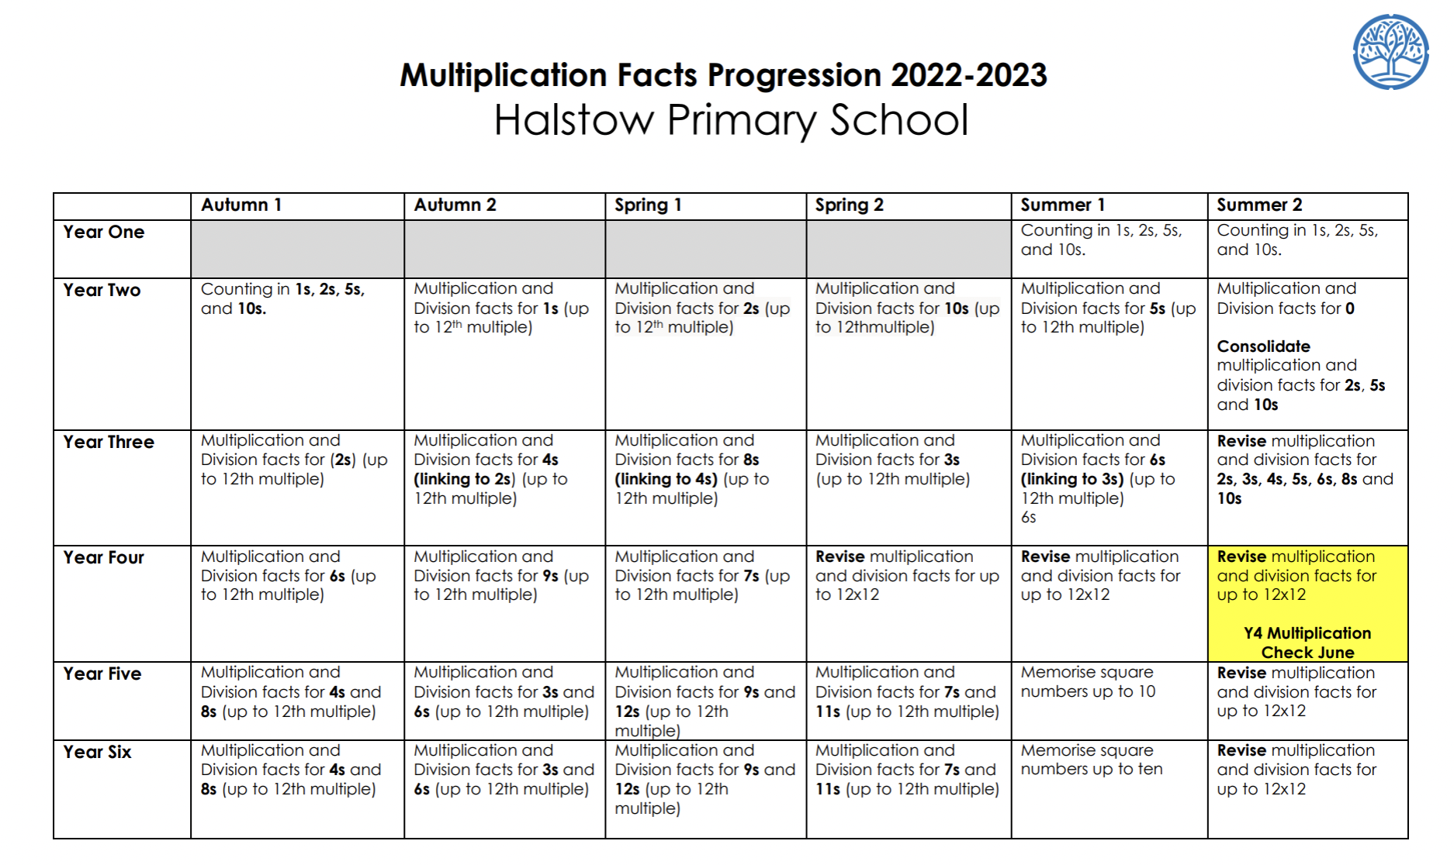
Multiplication Facts in our Maths Curriculum

Slide 27
Mathematical Thinking
Mathematical thinking is central to deep and sustainable learning.
Taught ideas that are understood deeply are not just ‘received’ passively but worked on by
the student. They need to be thought about, reasoned with and discussed.
Mathematical thinking involves:
  looking for patterns to discern structures
  looking for relationships and connecting ideas
  reasoning logically, explaining, conjecturing and proving.

Slide 28
How do we support higher attainers?
Mathematical Thinking
Encourage flexible thinking.
Encourage multiple methods.
Challenge them to spot patterns and make connections.
Support creative thinking.

Slide 29
Useful Questions to challenge children:
Mathematical Thinking
How many ways can you find?
Where did I go wrong? What should I have done?
Is that the only answer? How do you know?
Find another example. Find a non-example.
Convince me this is true.

Slide 30



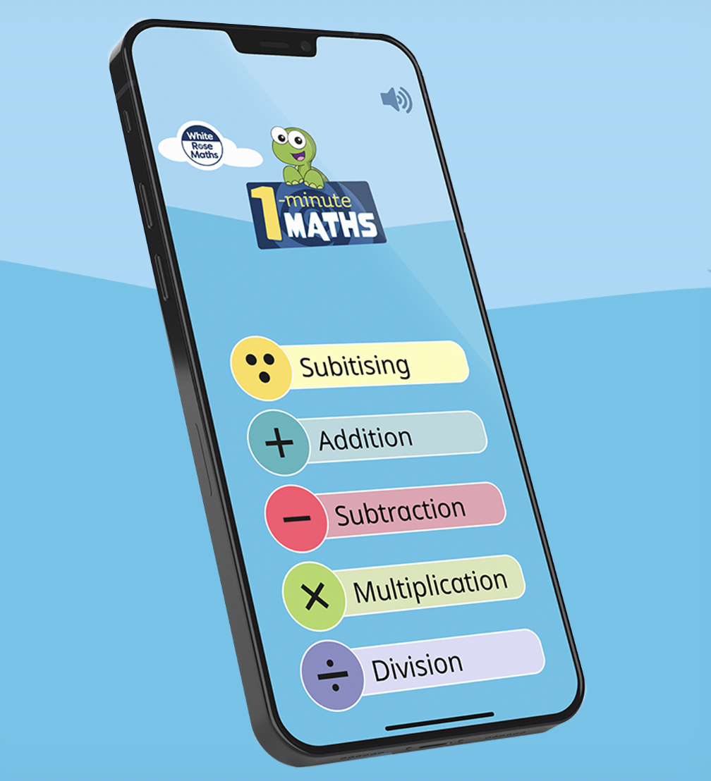
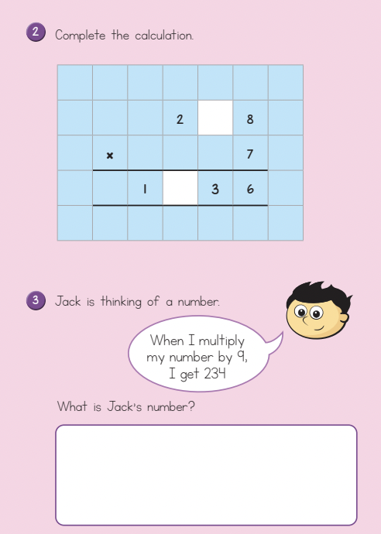
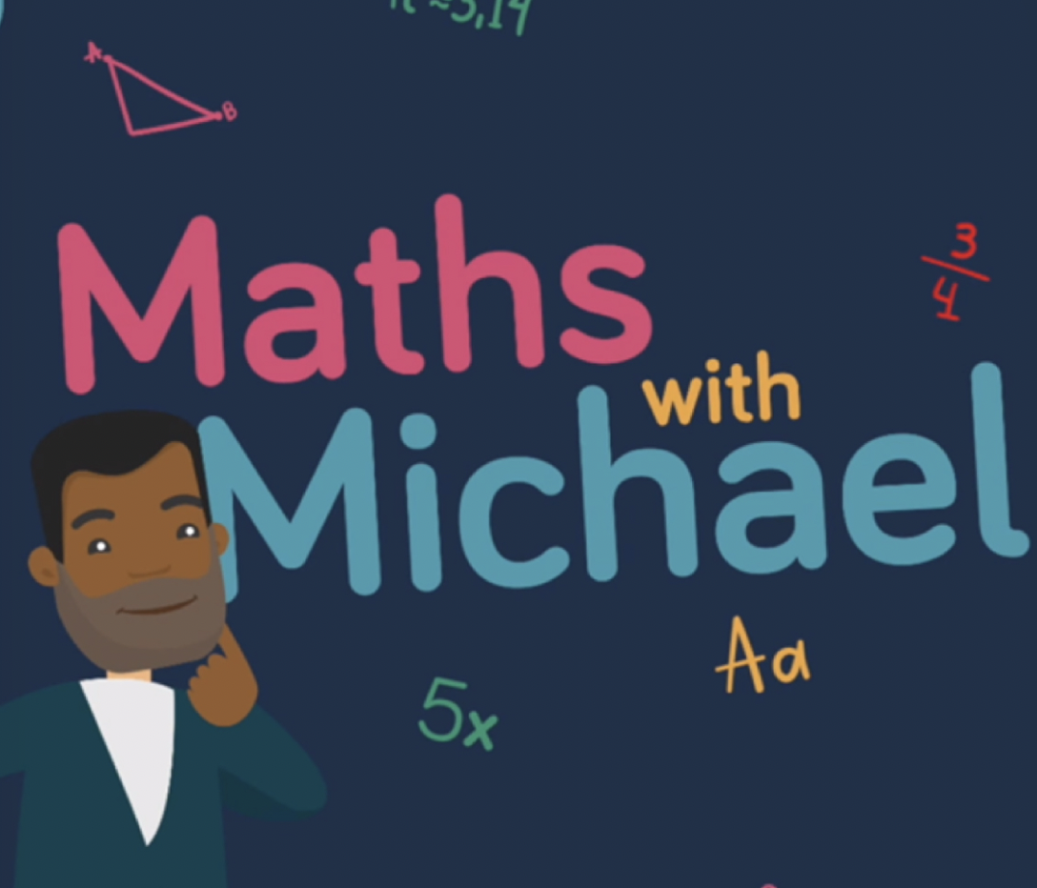
Useful resources to support your children at home.
Termly Booklets

Slide 31
Questions or comments?

