Slide 1

Multiplication Tables Check
Year 4

Slide 2
This year, the Multiplication Tables Check for year 4 children is happening between Monday 1st June and Friday 12th June 2026.
What is the Multiplication Tables Check?
The checks consist of 25 times tables questions. The questions will only be multiplication and they will go up to 12×12. There’s nothing novel about the questions and they don’t require problem solving so there’s nothing to trip them up.
There will be 6 seconds to answer each question.
The check will be taken online during school time.
Teachers will be able to apply for some children to be able to pause between questions.
Why do the children need to take this test?
All year 4 pupils in England will take the check. The Government made the check compulsory in 2022. They say:
The purpose of the MTC is to determine whether pupils can recall their times tables fluently, which is essential for future success in mathematics. It will help schools to identify pupils who have not yet mastered their times tables, so that additional support can be provided.
But why are times tables so important? Having rapid recall of times tables makes other areas of maths much easier. Fractions is the most obvious area where learning times tables well is essential. However, every multiplication, division, long multiplication method and short division and long division method require speed and instant recall of times tables while at primary school. At secondary school the needs become even greater. Furthermore, having the tables secure frees up their working memory for newer, more challenging tasks at hand. So learning them now, in year 4, sets children up for a more successful maths career later in their school life.

Slide 3
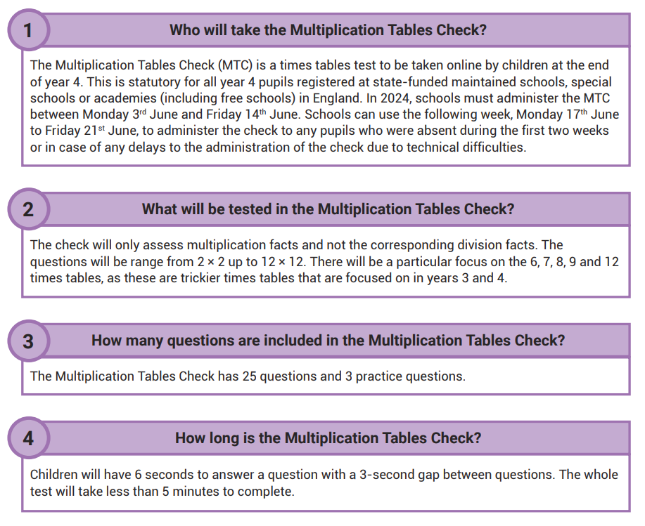

Slide 4
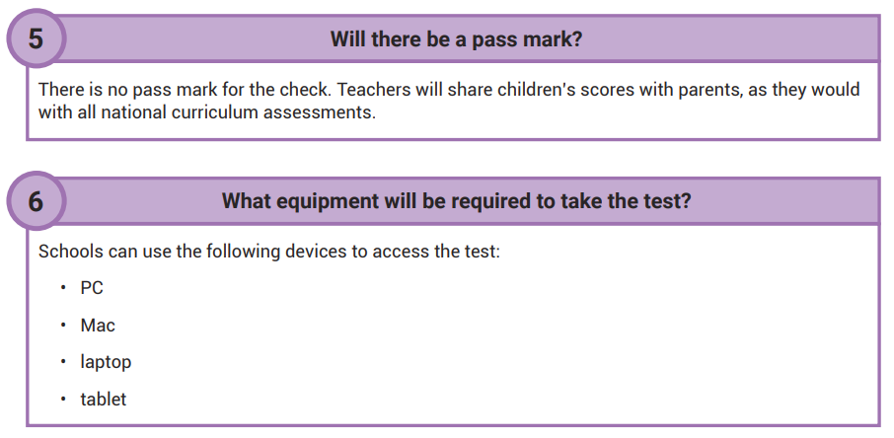
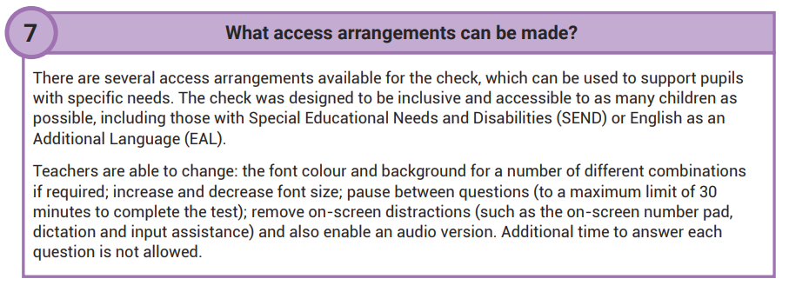

Slide 5
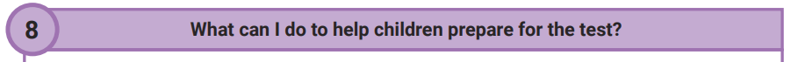
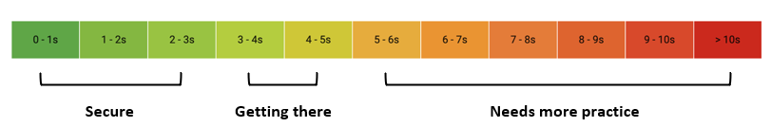
Sing times tables songs.
Chanting. Rehearse the tables forwards and backwards, gradually increasing in speed.
Write out the tables – This can be in the form of a simple list or you could also be a bit more fun. Being creative will make writing and learning the tables more enjoyable, such as writing the facts as the petals of a flower or on post it notes.
Take a pot of water and a paintbrush outside to ‘paint’ the facts on a wall.
Use chalks to write the facts outside in giant numbers.
Use websites, such as www.timestables.co.uk and www.ttrockstars.com
Every Halstow pupil has a login for Times Table Rock Stars (TTRS). On TTRS the Garage game mode is will adjust the questions your child is asked, ensuring they are always working on the facts they need to improve. Also, give them a times tables square to use whilst they play. This way they can double-check facts they are not sure about. On TTRS you can view your child’s heatmap (by logging in to your child’s account> Stats> Fluency). It shows their current recall time for each of the times tables facts. The greener the fact, the quicker the response time. Any facts shown in red or orange are slower than 5 seconds and should be practised. Spend some time with your child identifying which tables they need to practise, and celebrating the ones they already know.

