Slide 1

Reading at Halstow
Information Evening for Parents and Carers
Years 3, 4, 5 & 6

Slide 2

KS2 Reading Information Evening
Aims
Look at what the research says about reading and its importance
Understand the importance of fluency and how you can build this at home
Have a clear understanding of comprehension
Give hints and tips of how to get your child reading at home

Slide 3
Halstow Ethos
Through reading at Halstow, we want to foster…
enjoyment of reading
fluency
an inclusive environment
confidence as a reader
opportunity

Slide 4

In 2023, survey of 71,400 children and young people by the National Literacy Trust revealed that fewer than one in three children (28%) aged 8 to 18 read daily for enjoyment.

Slide 5
Impact of reading
Amount of reading per day | 20 mins | 5 mins | 1 min
Number of minutes per year | 3600 | 900 | 180
Number of words per year | 1.8 million | 282,000 | 8000
Hours read by the end of primary school | 851 | 212 | 42
Performance on tests | 90% | 50% | 10%

Slide 6
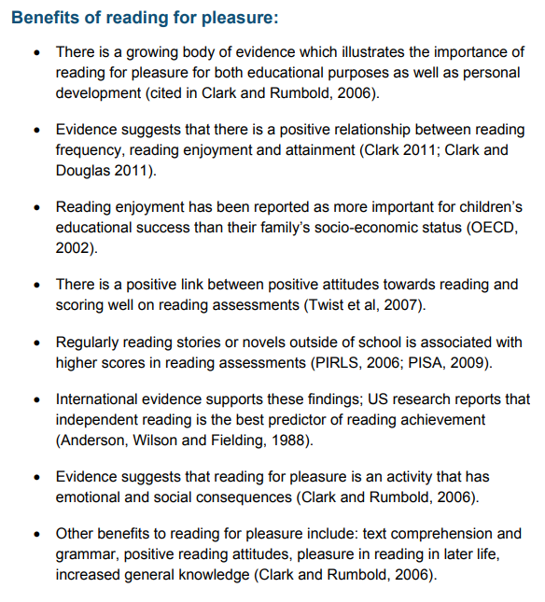

Slide 7
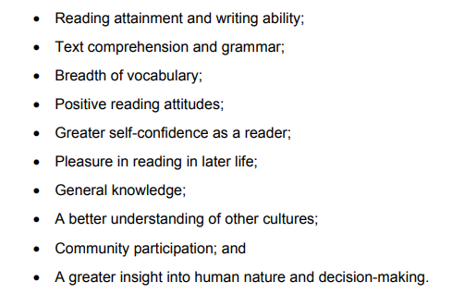
A growing number of studies show that promoting reading can have a major impact on children and adults and their future. Upon reviewing the research literature, these are some of the main areas of benefits to reading for pleasure.

Slide 8

The more fluently a child can read, the more they will enjoy independent reading.

Slide 9
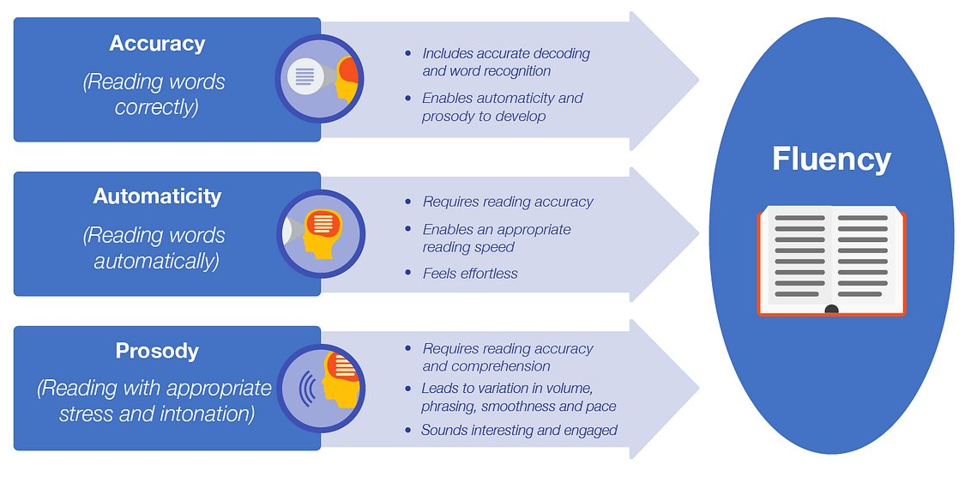
What is fluency and why is it important?

Slide 10
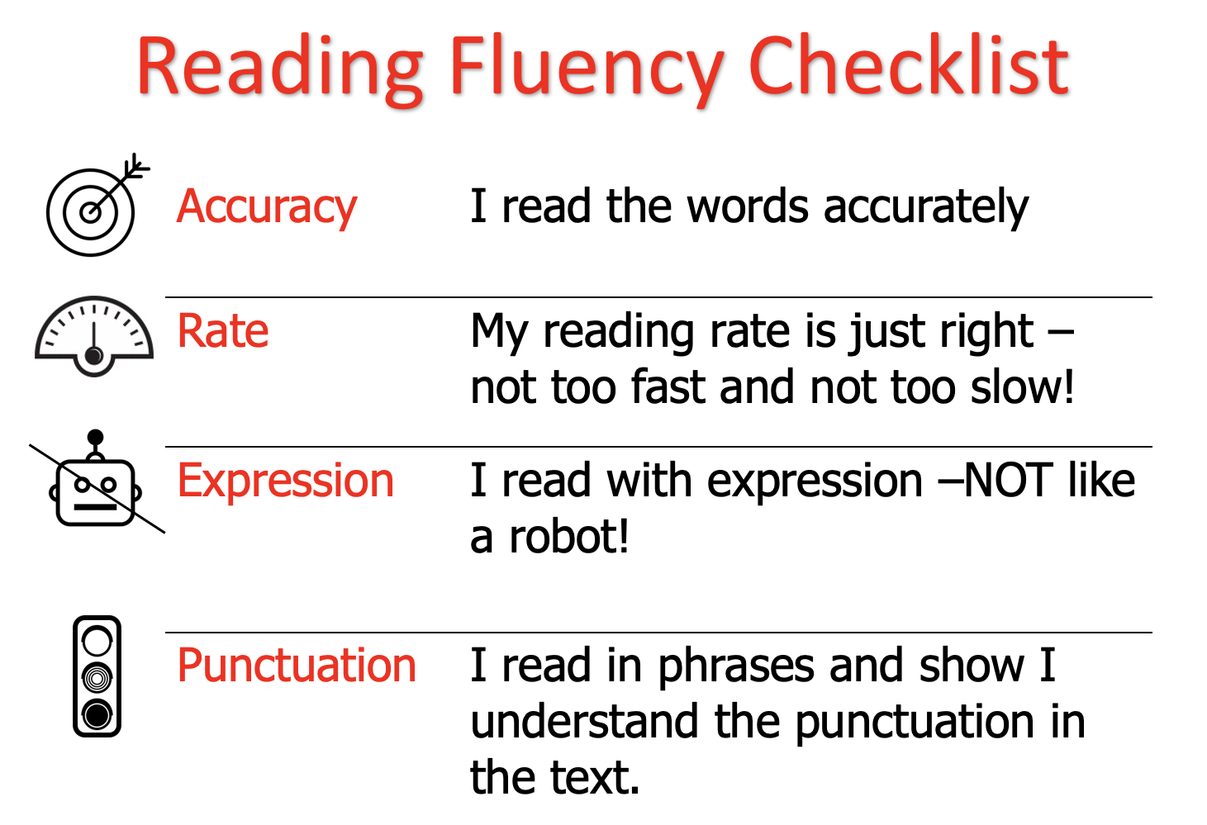

Slide 11

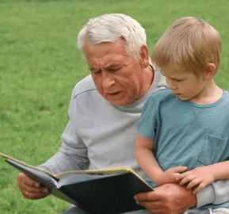
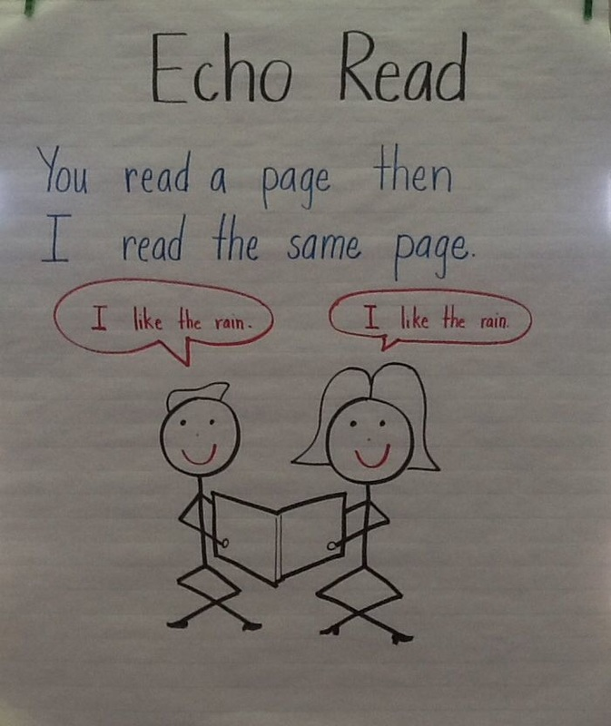
Three ways you can help build fluency at home…
Read and follow – the adult reads the text and the child follows along with their finger. This helps the child with word recognition and models to them how they should read with fluency.
My turn, your turn – take turns reading a page or a paragraph. Here you are modelling how to read with fluency, flow and expression.
Echo Reading – as you read, the child copies. It is important here to pace yourself and read at a rate that your child can keep up with.

Slide 12
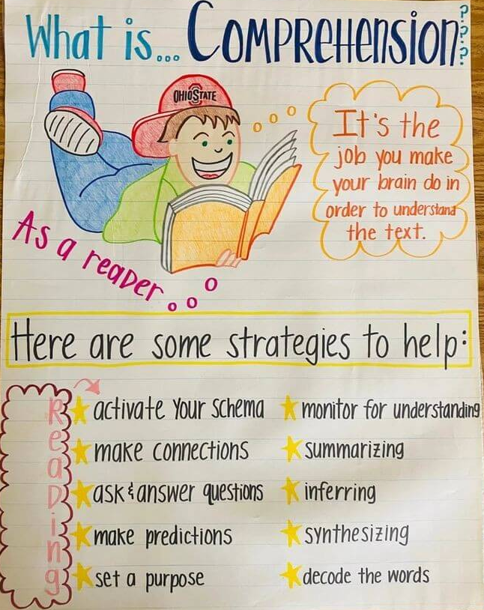
What is comprehension?
This refers to the understanding of a text.
Reading requires decoding and comprehension.

Slide 13
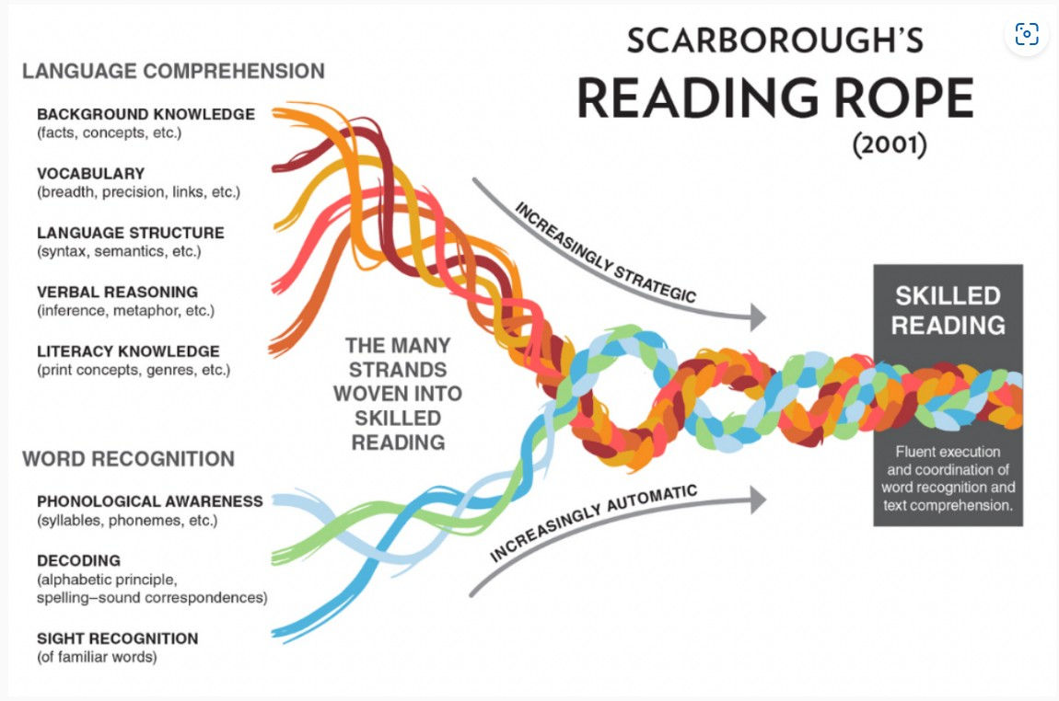

Slide 14

This is all great, but my child never chooses to read at home!
What can I do to help encourage them?

Slide 15
This is all great, but my child never chooses to read at home!
What can I do to help encourage them?
And crucially…
We know that children do what they are shown more than what they are told. If you model that reading books is just something adults like to do at home too, they are more likely to follow suit.

Slide 16







Activate prior knowledge
Question
Infer
What are the habits of a good reader?
Summarise
Predict
Monitor your comprehension
Visualise

Slide 17
What does reading look like at Halstow for KS2?
Vocabulary
Making Meaning
Making Meaning
Book Talk
Unseen Comprehension

Slide 18




How does reading help my child's writing?
Schema
Sentence structures
Vocabulary
Spellings

Slide 19
How else can I support my child's writing?
Talk – about anything!
Go out in the world
Let them see you write
Read their writing - discuss their authorial choices

Slide 20
Any questions?

