Slide 1

Secondary School Admission
Information Evening for Parents and Carers

Slide 2
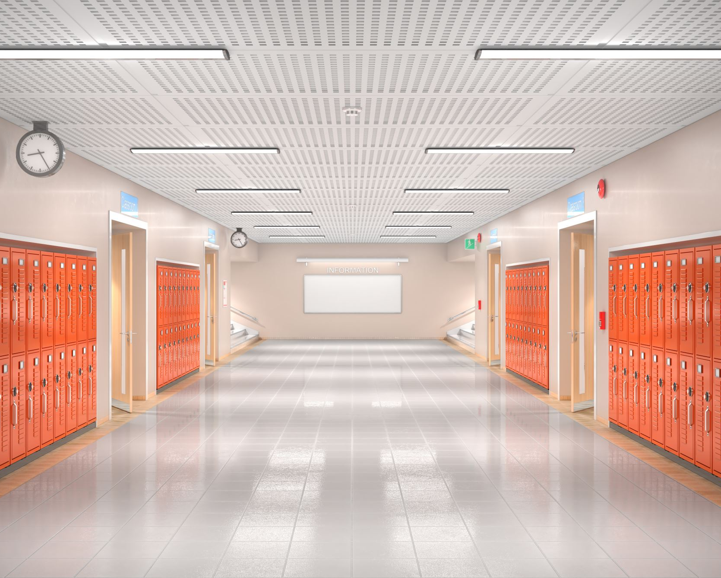
Secondary School application procedures and deadlines vary, depending if you are applying for:
State schools – Royal Greenwich borough schools
Grammar schools – Kent, Bromley, Bexley
Independent schools – private schools, such as Colfes and Blackheath High
ALWAYS check the council and school websites for the most up to date information.

Slide 3
Independent and Grammar
For independent schools your child will need to sit an entrance exam.
For grammar schools your child will need to sit an academic test.
Independent and grammar tests are selective and designed to be challenging.
Depending on which grammar school it is, you will need to register in Year 5 for your child to sit a test in September Year 6. If you are applying for more than one grammar in a borough, you will only need to take the test once.
The Kent test is an exam used by grammar schools in Kent (e.g. Dartford Grammar).
London Borough of Bexley uses an academic exam for selection for grammar schools (e.g. Beths Grammar School, Bexley Grammar School, Chislehurst and Sidcup Grammar School, Townley Grammar School).
London Borough of Bromley use an academic exam for selection for grammar schools (e.g. Newstead Wood School and St Olave’s Grammar School).

Slide 4
Choosing your child’s school…
Siblings, family and friends
Distance from home
Transport routes
School specialisms
School culture
Additional Needs
https://www.royalgreenwich.gov.uk/directory/31/secondary_schools

Slide 5
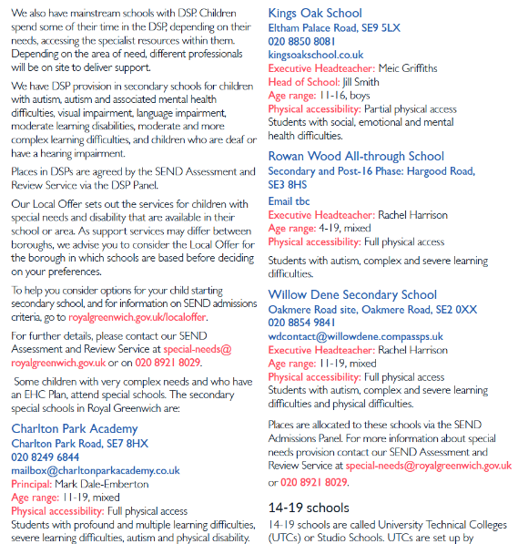
Children with additional needs
If your child had additional needs and you would like help considering your options, visit www.royalgreenwich.gov.uk/localoffer
If your child has an Education, Health and Care Plan (EHCP) you need to apply through a separate process (you do not complete the standard application form). Contact the Greenwich SEND Assessment and Review Service at special-needs@royalgreenwich.gov.uk
or telephone 020 8921 8029.
https://greenwichcommunitydirectory.org.uk/children-young-people-additional-needs/choosing-and-getting-school
Notes:
Take pictures

Slide 6
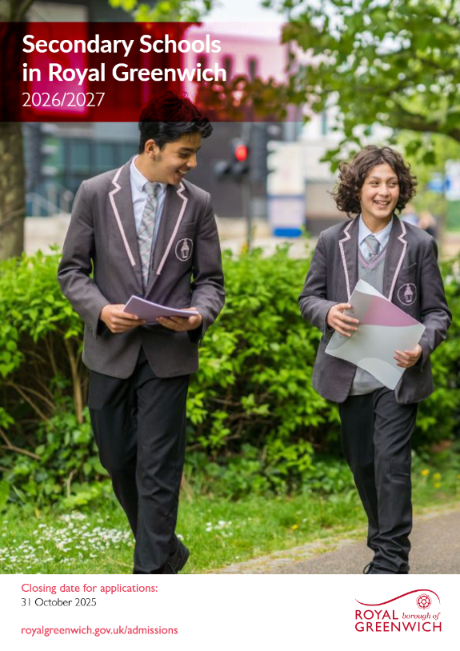
Admission to Secondary School in Royal Greenwich for September 2026

Slide 7
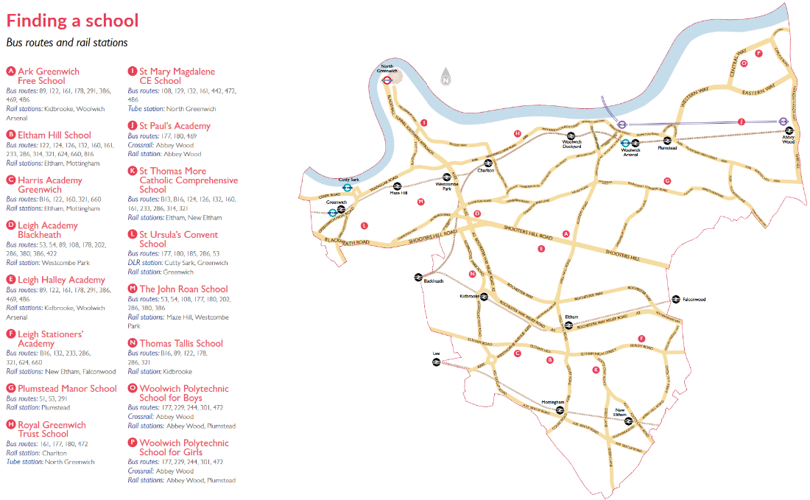
Admissions Arrangements
When there are more applications than places, admissions will look at the following:
Looked after children
EHCP (Educational Health Care Plan)
Acute medical conditions or social care need
Children with siblings at the school
Home to school distance
Faith (faith schools have a certain number of places for faith applicants)
Children of staff
https://edition.pagesuite-professional.co.uk/html5/reader/production/default.aspx?pubname=&pubid=544b8783-16f8-47e1-aa52-9701795c26c5

Slide 8
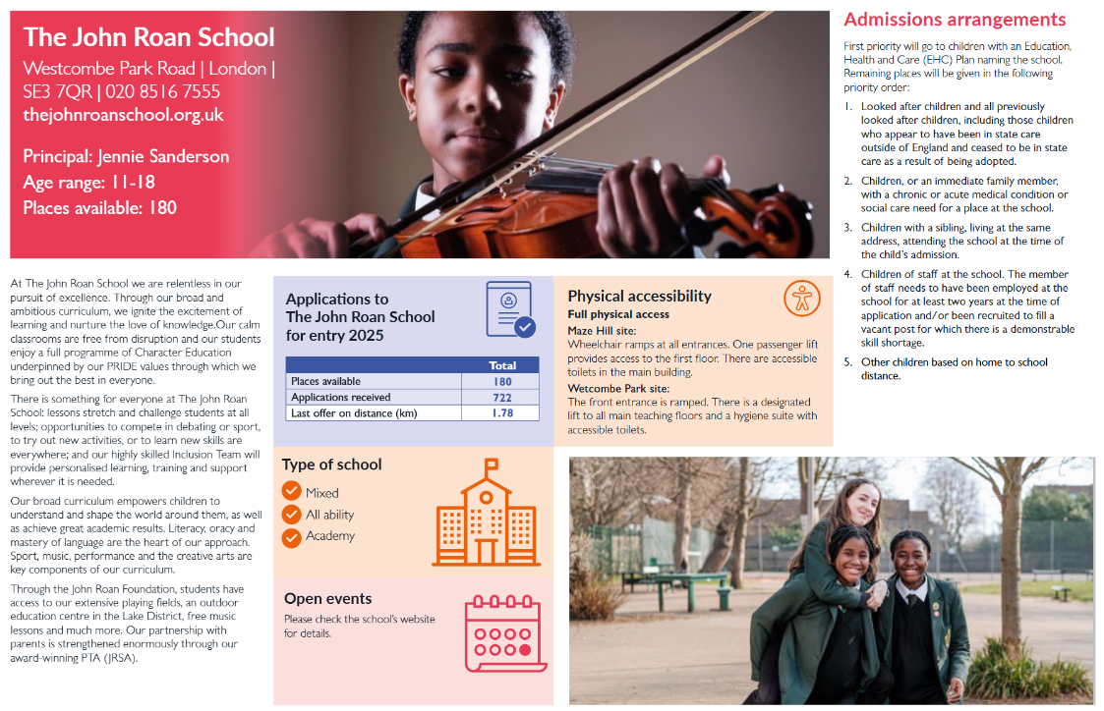

Slide 9
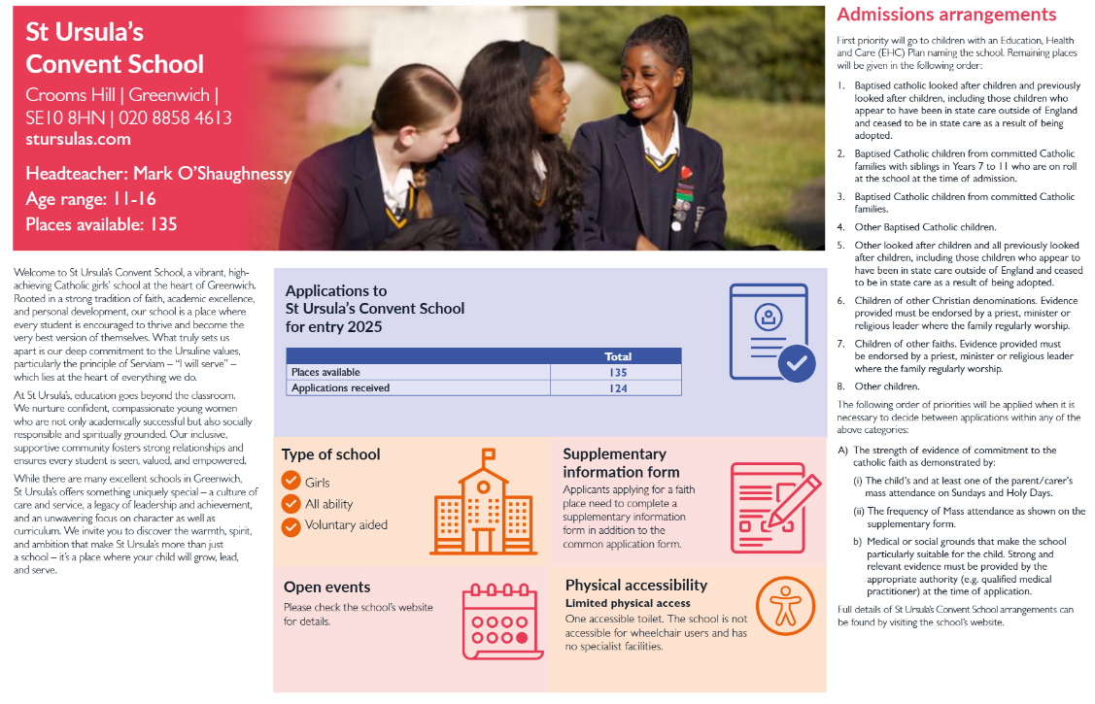

Slide 10
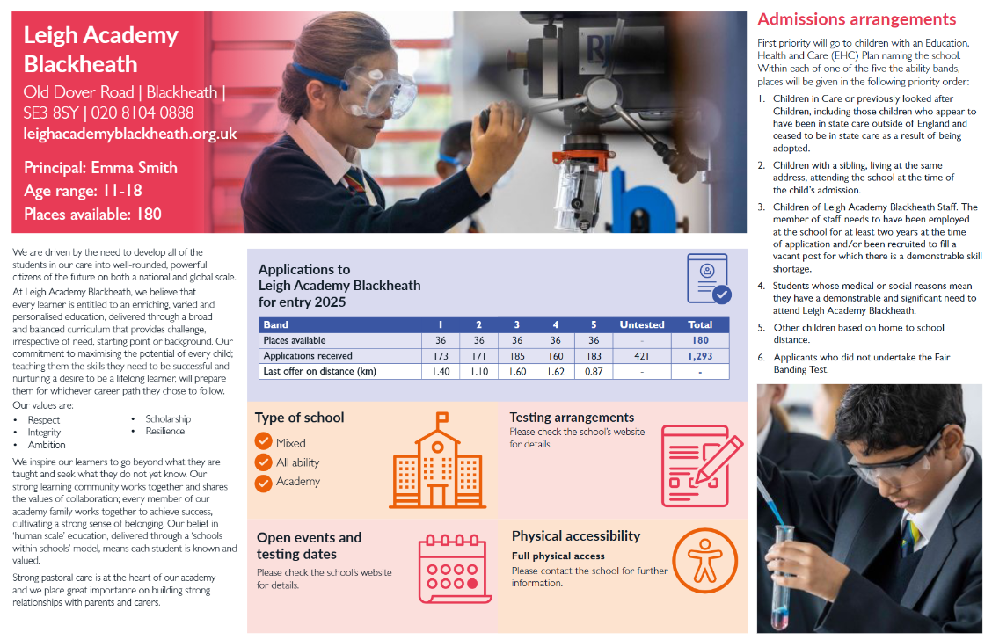

Slide 11
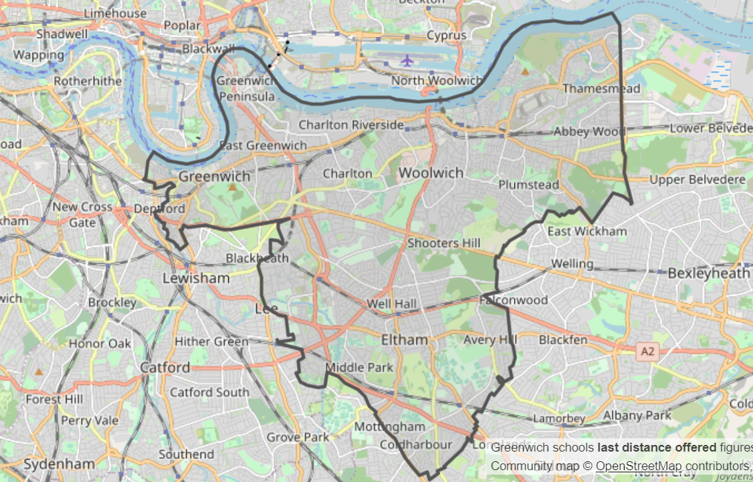
Royal Borough of Greenwich
https://www.royalgreenwich.gov.uk/info/200286/apply_for_a_school_place/1400/secondary_school_offers_interactive_map

Slide 12
Open Days/Open Evenings
Usually, schools are able to offer open evenings and open mornings - this is an opportunity for you and your family to look around the schools so that you can get a better idea of they are like.
School websites and Greenwich's admission website show the dates at the beginning of September and begin their open days from September.
We advise parents to visit a variety of schools, if possible, to make an informed decision about where your child will attend secondary school. If you are planning on attending open day events with your child during the school day, you will need to inform the school office. All visits to secondary schools will be entered in the register as an approved absence. We ask that children return to school after visiting prospective schools.
https://www.royalgreenwich.gov.uk/schools-and-education/apply-school-place/apply-secondary-school-place/attend-secondary-school-open

Slide 13

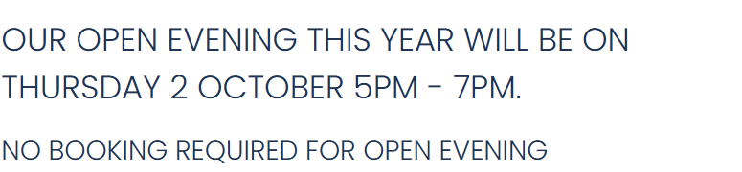
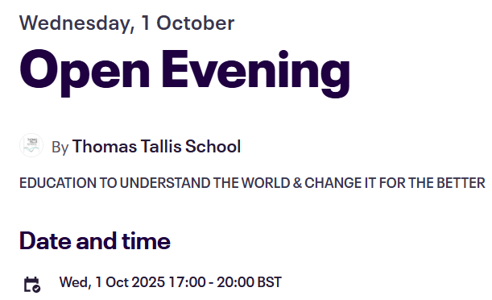
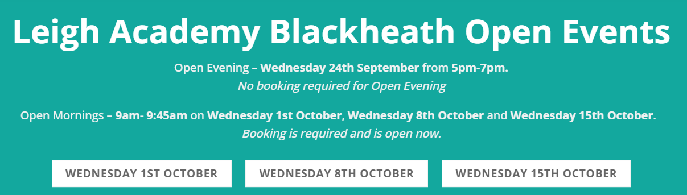
John Roan
St Mary Magdalene Academy
Thomas Tallis
https://www.thejohnroanschool.org.uk/admissions/open-events-tours
Leigh Academy Blackheath
https://www.eventbrite.co.uk/e/open-evening-tickets-1460576326109
https://leighacademyblackheath.org.uk/

Slide 14
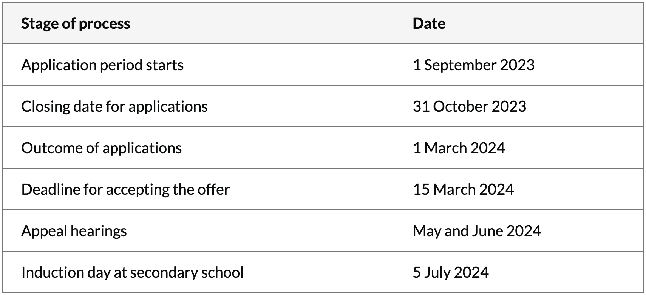
Timetable for entry to Greenwich borough schools 2026
Actual dates will be announced on the school admissions website in September
1st September 2025
31st October 2025
2nd March 2026
16th March 2026
May and June 2026
2nd July 2026
Notes:
Take pictures

Slide 15
How to Apply
To make an application, you must have parental responsibility for the child. If you are not the child’s parent, you will need to provide proof of guardianship such as child arrangements or court order.
Applying online – open for applications 24 hours a day and you’ll receive confirmation that your application has been submitted successfully. The result arrives more quickly www.eadmissions.org.uk
For a paper application to be emailed to you as a PDF to then be posted back, you can email: school-admissions@royalgreenwich.gov.uk
List up to six preferences, in preference order
For a Greenwich school, you must apply through Greenwich

Slide 16
Tips on using your 6 preferences wisely:
Your preferences are up to you but be realistic! There's no guarantee you'll be offered a place at a preference school, but here are some recommendations:
Don't 'waste' a preference by naming a school where your child is unlikely to be offered a place
Don't name a school that you'd not wish your child to attend - any preference may be offered
Don't list the same school more than once as duplicates will be deleted
Include schools nearest to your home address - otherwise, your child may end up being allocated to a school much further away.
Put as many schools as you can.

Slide 17
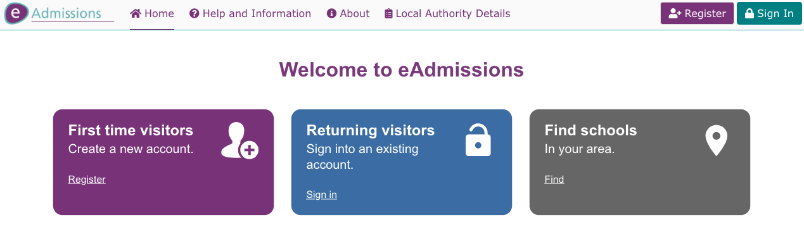
Applying online
eadmissions.org.uk

Slide 18
Some schools require a supplementary form:
St Mary Magdalene
St Paul’s Academy
St Thomas More Catholic School
St Ursula’s Convent School
Other schools ask applicants to sit a general ability test:
Leigh Academy Blackheath
Leigh Stationers’ Academy
Leigh Halley Academy
Harris Academy Greenwich
As some schools require supplementary information to register your child, please contact/research each school for further information.

Slide 19
Application Forms
Greenwich residents can apply online www.eadmissions.org.uk or obtain a paper copy by emailing school-admissions@royalgreenwich.gov.uk
Non-Greenwich residents can obtain an application form from their local council.
Proof of address must be attached (normally a council tax number). If you are not registered to pay council tax, then you’ll be asked for a tenancy agreement, mortgage letter or utility bill, etc.

Slide 20
How to get help with your application
The Greenwich School’s Admissions website is informative:
www.royalgreenwich.gov.uk/admissions
The Families Information Service offers support to parents and carers who may need support with the school admissions process. The service is available to everyone and provides:
    a wide range of information on local secondary schools
    support in making informed and realistic preferences
    help in completing the relevant forms
    information about the appeals process.
If you have questions about which schools will best meet your child's academic and developmental needs, or you require support in making your application, please contact the Families Information Service.
Telephone: 020 8921 6921
Email: fis@royalgreenwich.gov.uk

Slide 21
We can help…
Provide internet and device support to allow parents and carers to look through the e-booklet
Support with completing the application form
Help to answer questions you might have

Slide 22
Questions
https://www.royalgreenwich.gov.uk/schools-and-education/apply-school-place/apply-secondary-school-place

