Slide 1

Assessment at Halstow
Information Evening for Parents and Carers
Reception to Year 6

Slide 2

Why Do We Assess Children?
To understand what children know and can do
To inform planning and teaching
To support children’s progress and identify next steps
To report to parents and prepare for the next stage

Slide 3

Types of Assessment
Formative: ongoing, daily, responsive
Summative: more formal tests and tasks
Statutory: government-required assessments at key points
To inform teaching and learning and to identify gaps and misconceptions to inform lesson planning accordingly.
To evaluate what the children have learnt and retained over a period of time or unit of learning, and track progress.

Slide 4
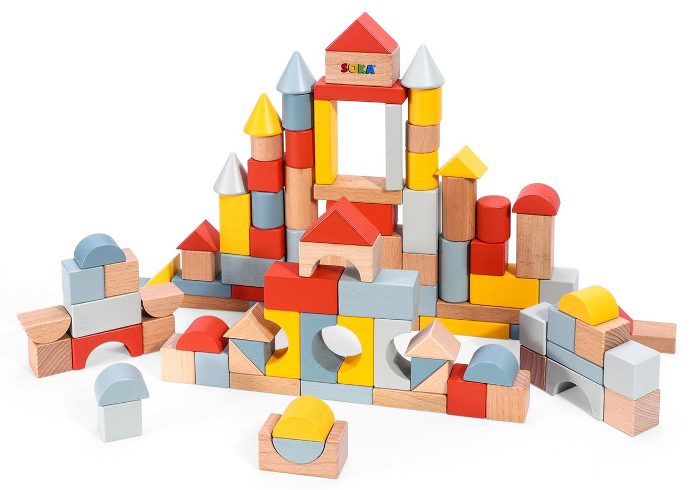
How we assess
Assessment happens all day, every day in our classrooms!
It provides educators with important information about what the children know and can do, and how they are approaching their learning.
Assessment takes many different forms:
observations
questioning
discussions
peer assessment
self assessment
informal tests and quizzes
marking and verbal feedback
formal tests
…and many more!

Slide 5
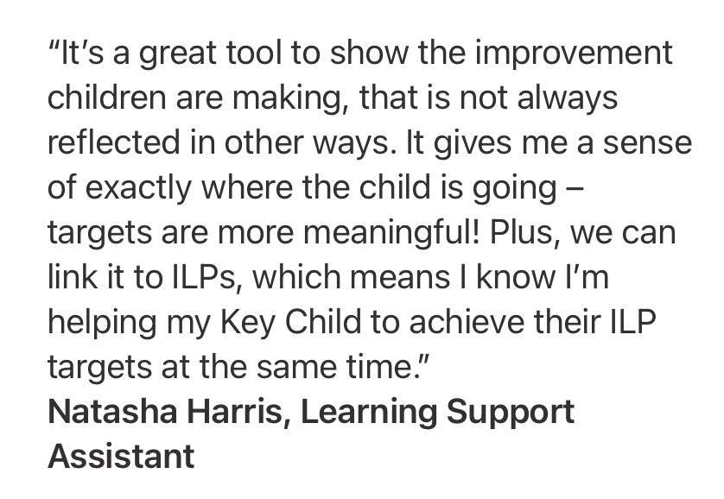

Learning Journeys
For some of our children, assessment will need to look different to effectively support their own learning journey.
Some children with Special Educational Needs are working below the National Curriculum level (below Reception level).
These children are assessed by Learning Journeys.

Slide 6
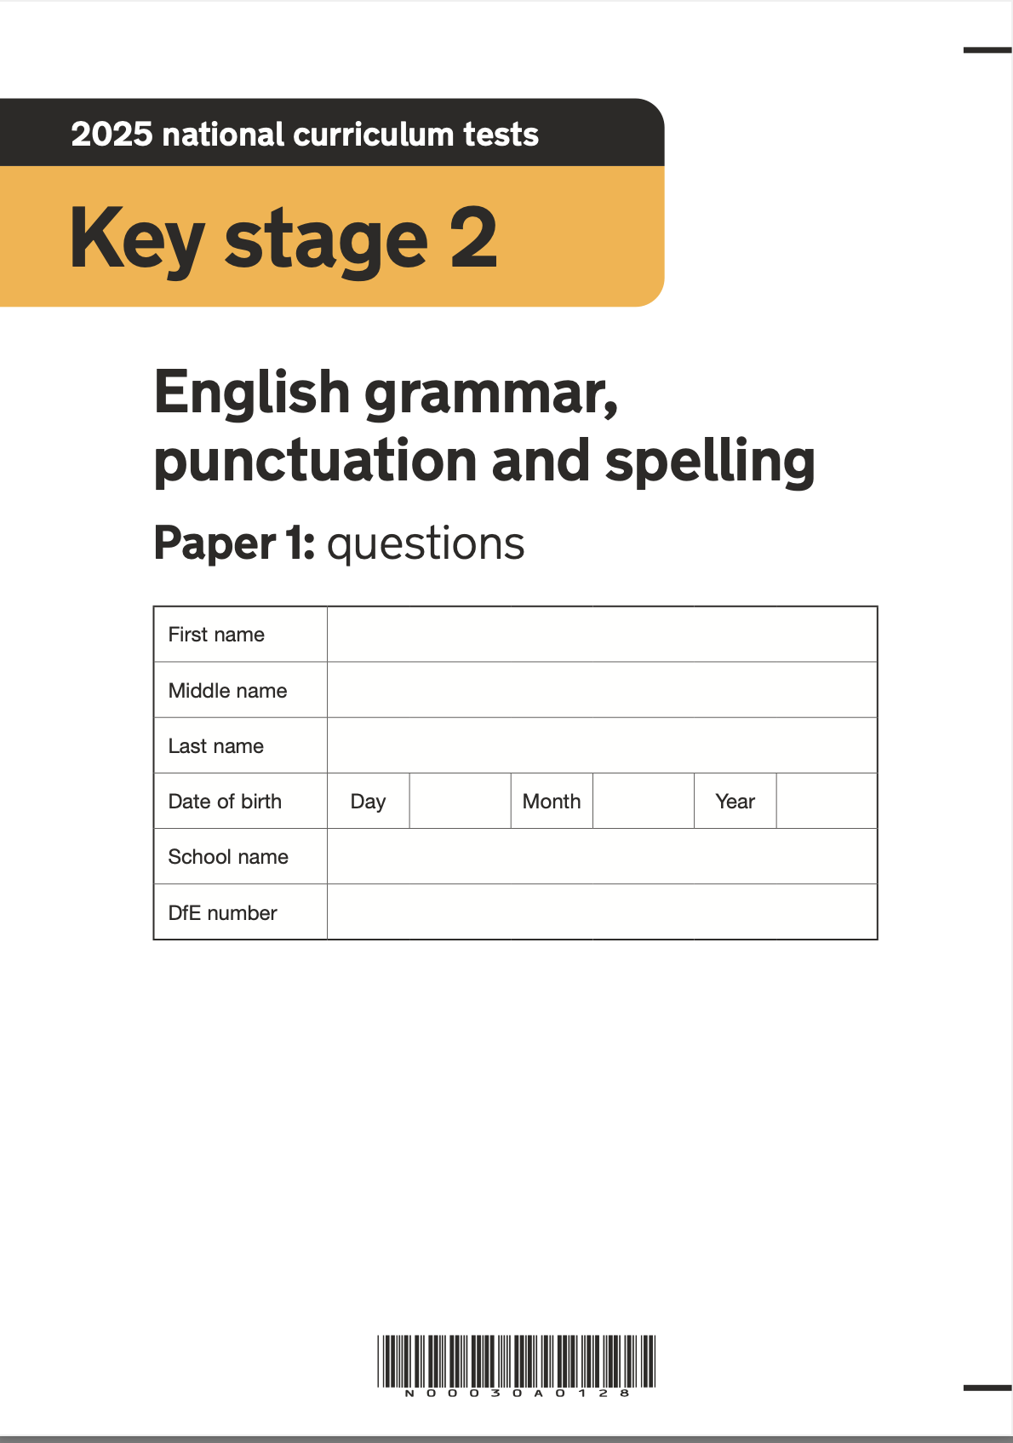
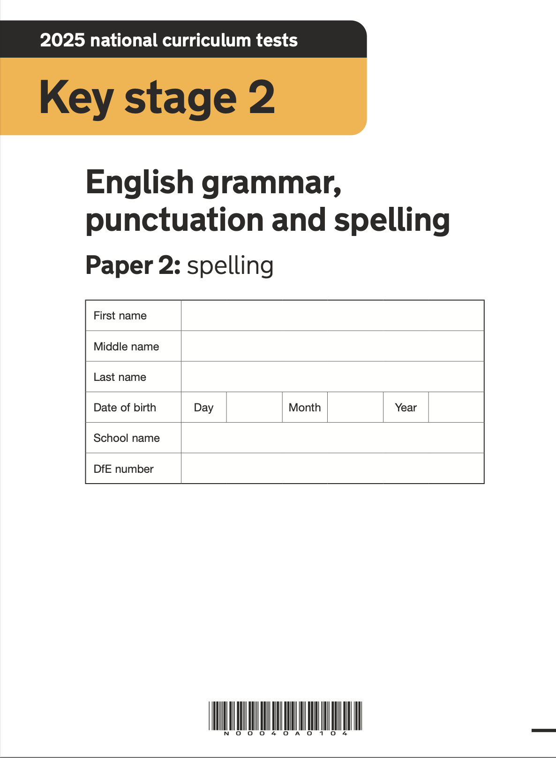
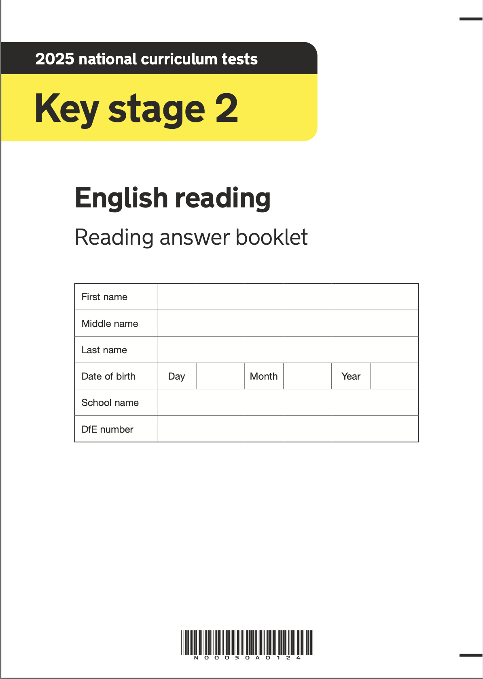
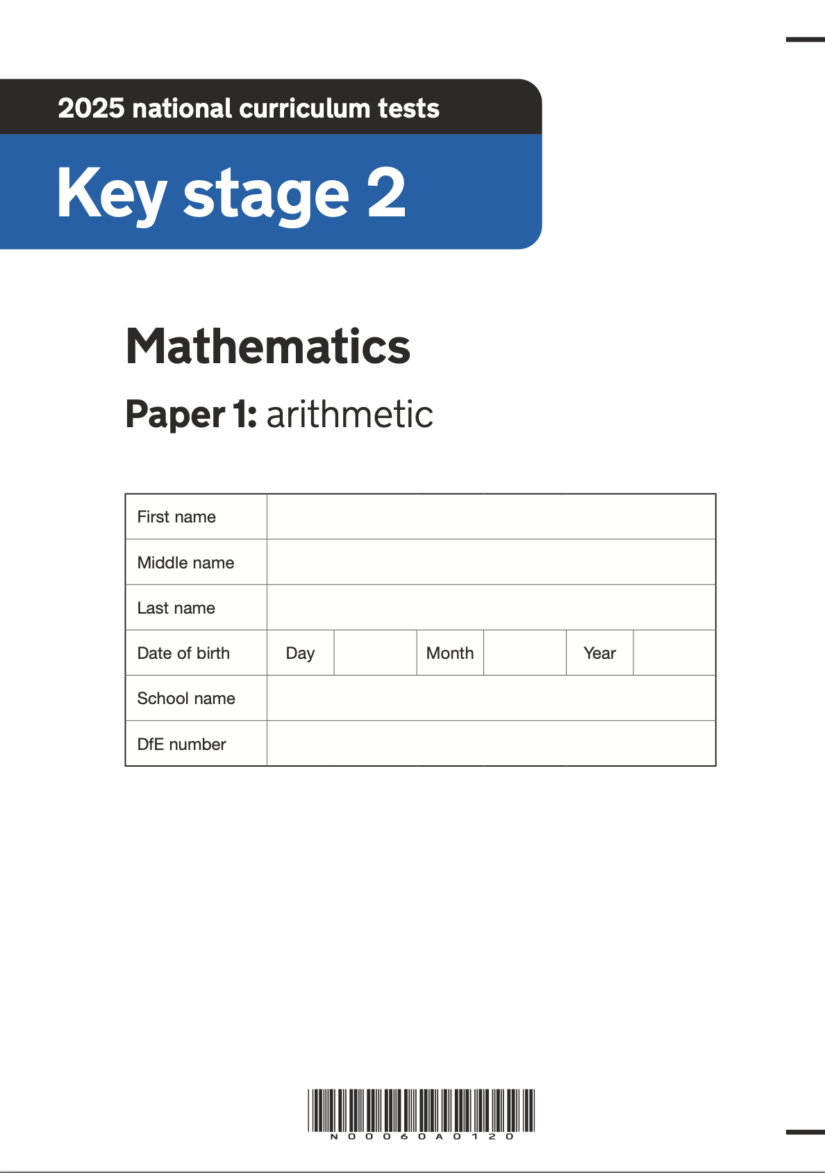
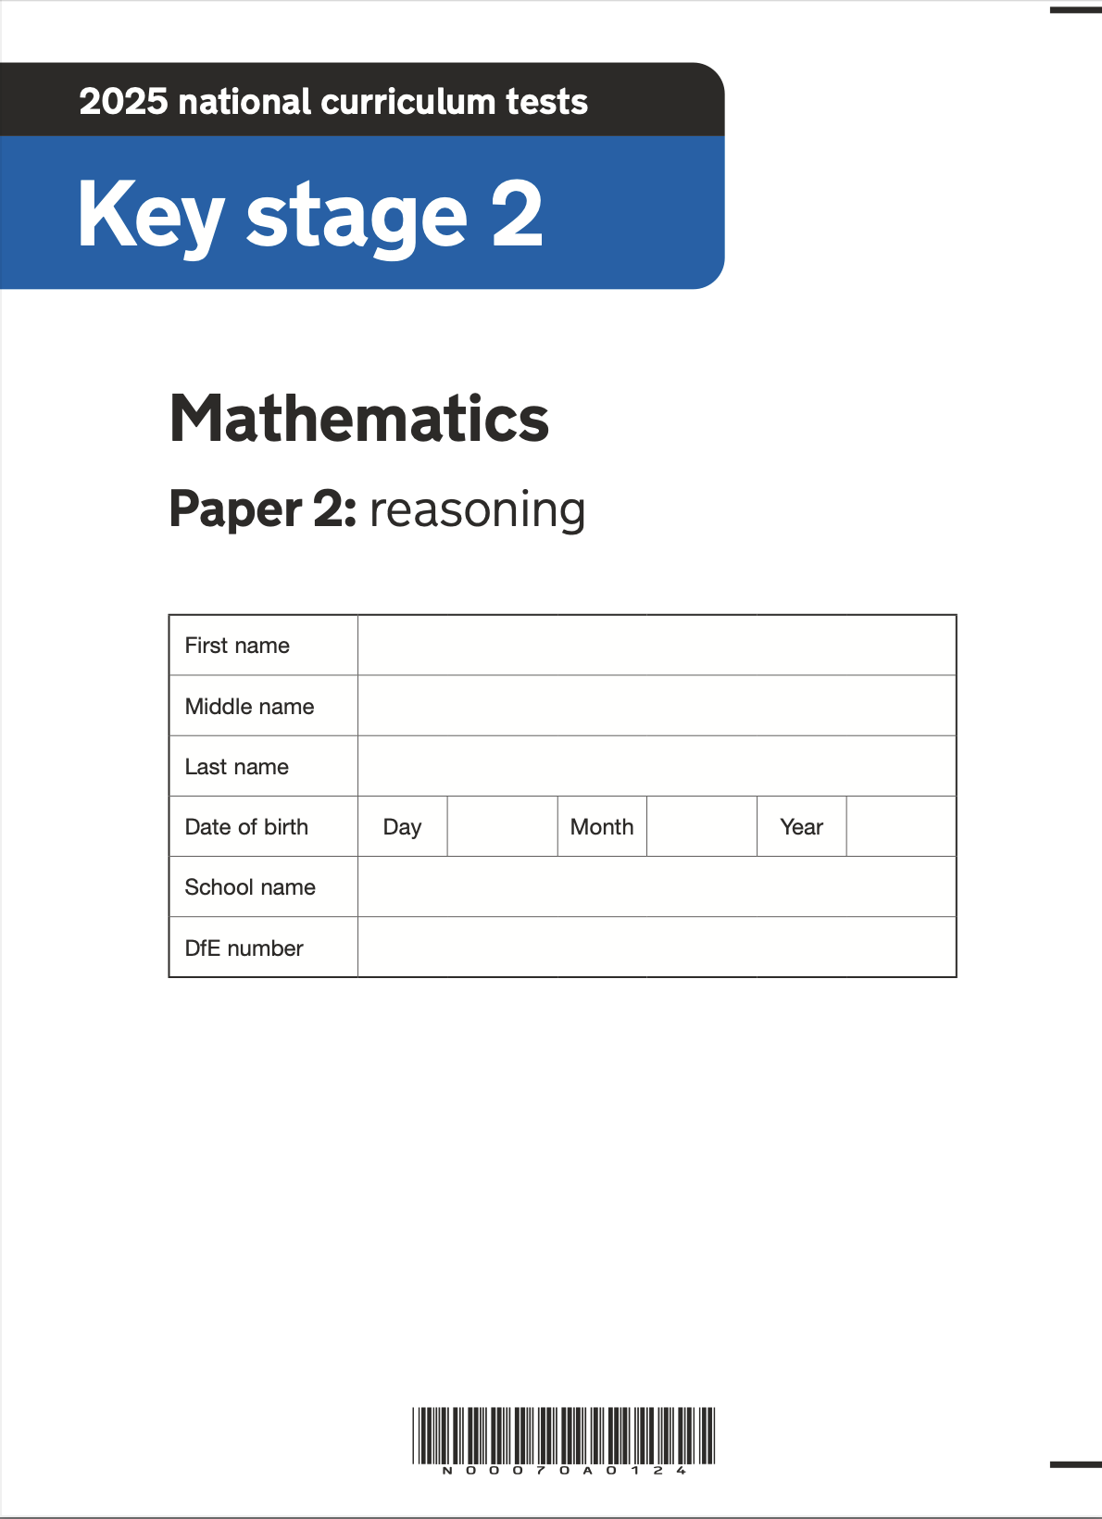
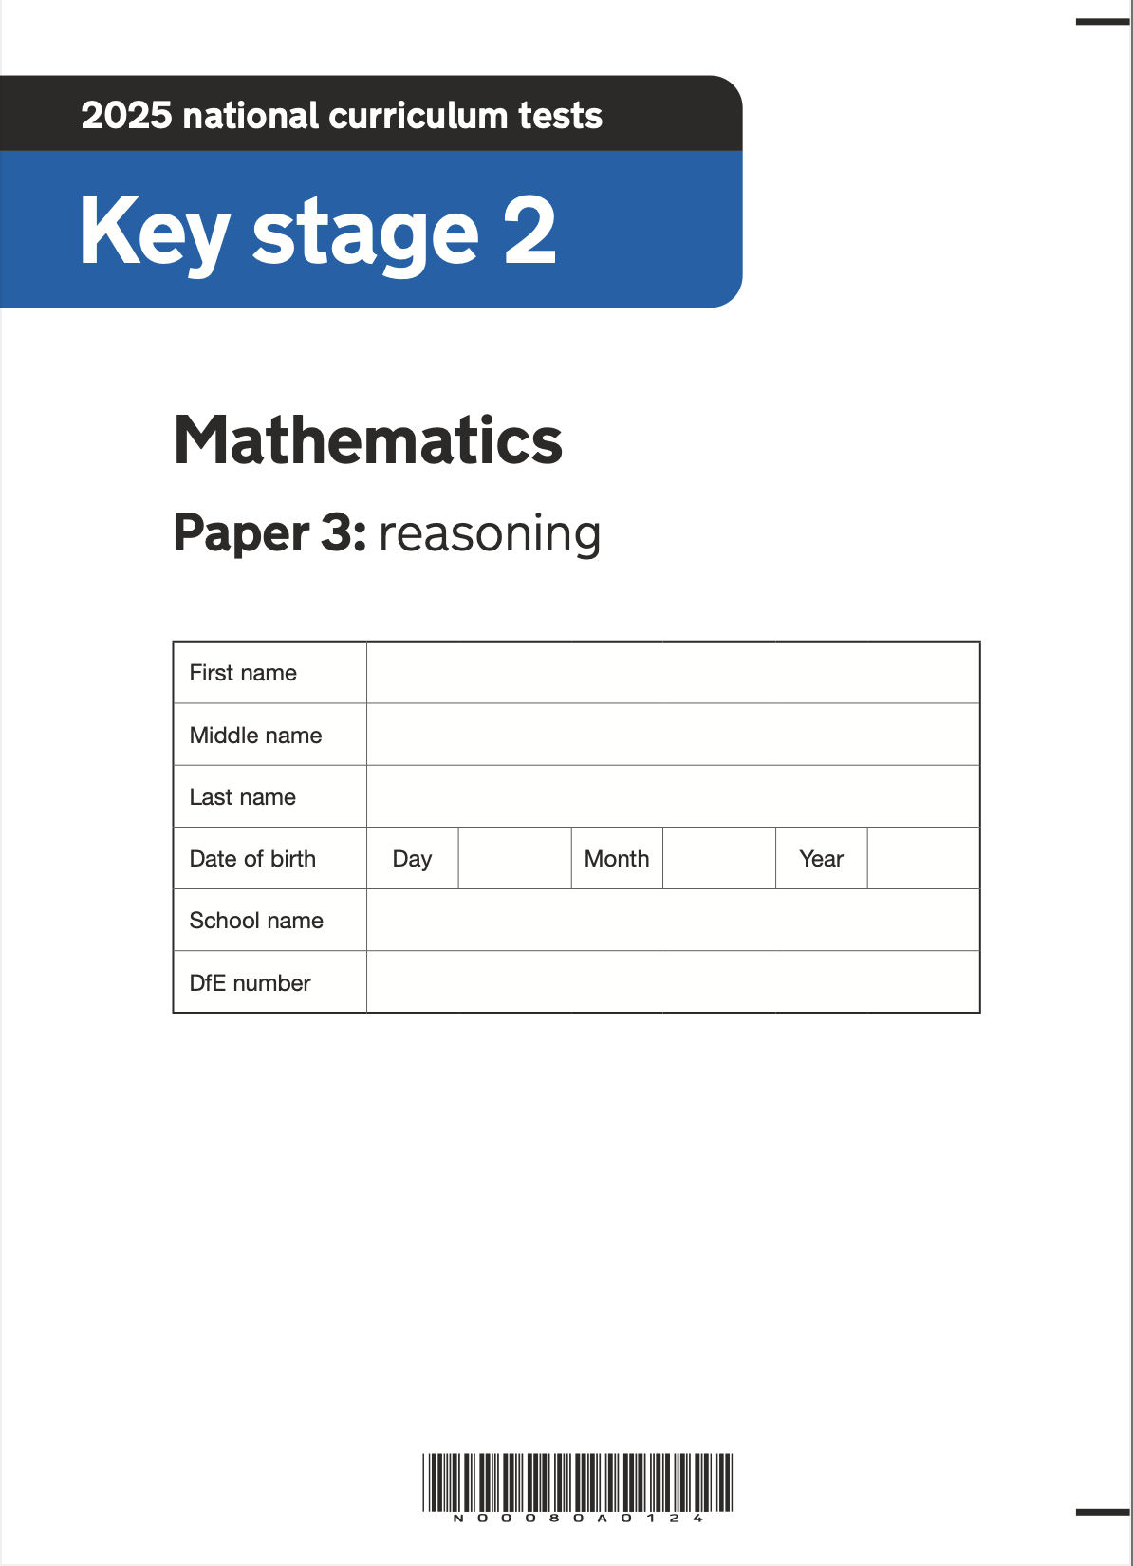
Statutory Assessments
Reception - Baseline Assessment
Reception - EYFS Profile (GLD)
Year 1 - Phonics Screening Test
Year 4 - Multiplication Tables Check
Year 6 – KS2 National Curriculum tests in Maths, Reading and Grammar and Spelling with outcomes in the form of scaled scores (SATs)
Year 6 – KS2 Writing and Science using the STA Frameworks for Teacher Assessment (with randomised moderation).

Slide 7
Language of Assessments
Our internal assessments in school will assess children in each subject as either…
  working towards age-related expected standard (WTS or WTARE)
  working at the age-related expectation (ARE)
  working above the age-related expectation (AARE or GDS*)
If your child is WTS in a subject, their class teacher will be able to tell you at what year group and term they are working at. For example, a child in Year 5 in writing may be working at the level of Spring Y4, meaning they are 4 terms behind ARE. Your child’s class teacher (and/or Miss Bunzl) will also be able to talk to you about what is happening to support your child in making accelerated progress.
*At the end of Year 6, ‘working above age-related expectation’ is called working at the Greater Depth Standard (GDS). The term GDS can be used interchangeably with AARE.
In the statutory KS2 SATs, GDS can be achieved in Reading, Writing, Maths, Grammar and Spelling.
In Science, the DfE only record if a child has met the standard or not. We will give a teacher assessment on their school report which might be GDS, but don’t be alarmed if you see their grade from the DfE is ARE. They do not go higher than this for primary science.

Slide 8
Teacher Assessments
Children in Year 1 to 6 are assessed against the Compass Partnership Progression and Assessment Framework in reading, writing, maths and science.
This is used to track progress and identify gaps in learning.
Children are assessed in a range of ways including through questioning, observation, discussion, the children’s learning in their books and planned assessment tasks. Assessment Weeks occur between 1-3 times per year depending on the year group; this is when children practise taking a more formal assessment.
All of this information is collected termly and analysed.
Other foundation subjects are assessed and overall attainment for each subject is recorded at the end of the year and sent to you in their school report.

Slide 9

Reception – Early Years Foundation Stage (EYFS)
Daily informal assessment through play and interaction to see what children can do and what they know.
During the first 6 weeks of Reception, a statutory Baseline Assessment will be carried out. This is carried out through a variety of activities including maths tasks, and language and communication tasks.

Slide 10
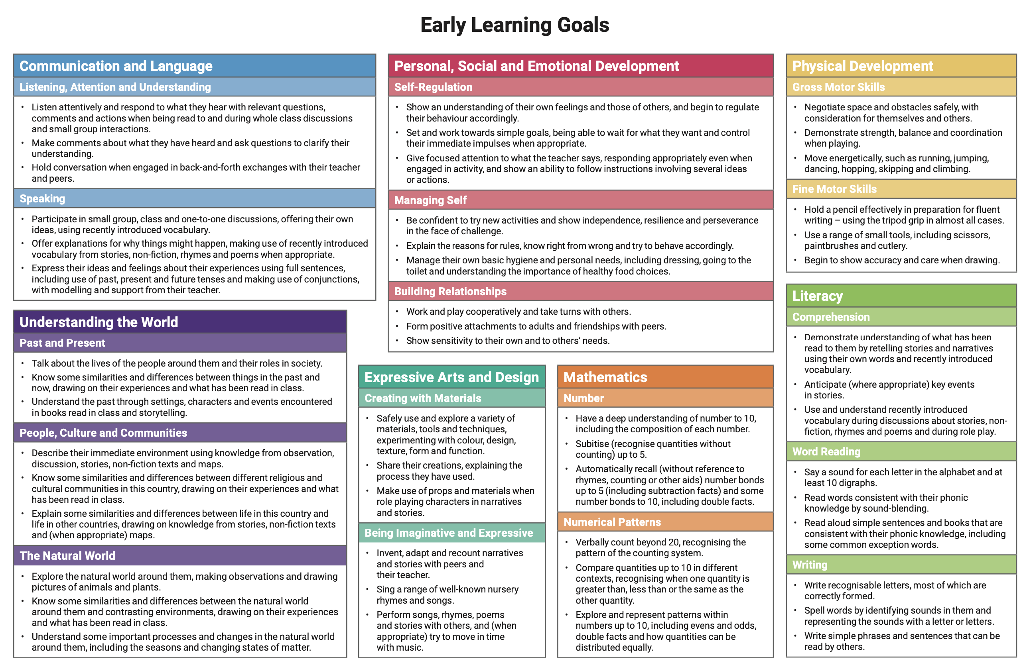
Reception – Early Years Foundation Stage (EYFS)
Children in Reception are working towards achieving the 17 Early Learning Goals identified in the EYFS Assessment Framework.
At the end of Reception, children will be teacher assessed as Emerging (not yet met) or Expected (has met) against the criteria for each Early Learning Goal.
In order to achieve the Good Level Of Development (GLD) by the end of Reception, children must have met expectation in the the 12 prime areas.

Slide 11

Year 1 – Phonics Screening Test
In Reception and Year 1, children are assessed every half term on their phonics to ensure they are keeping up with the Little Wandle programme.
In Year 1, children are formally assessed on their phonic knowledge and application using the statutory Year 1 Phonic Screening Test.
Parents and carers are informed as to whether or not children have or have not met the required standard for phonics in year 1
Children who did not meet the required standard are retested in Year 2.

Slide 12
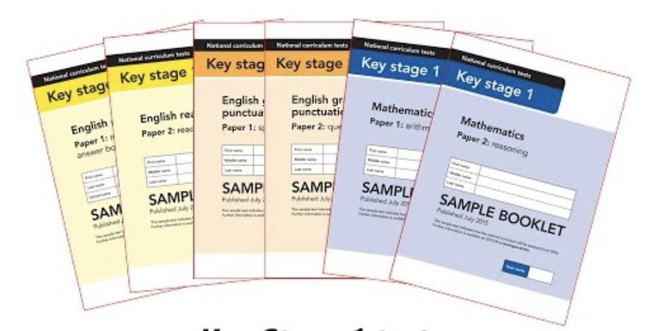
Year 2 – KS1 SATs (non-statutory)
The KS1 SATs are no longer statutory (since 2024), but are still written by the DfE for schools to access.
The Compass Partnership schools all use them as an internal assessment tool.
There are papers in Reading, Grammar, Punctuation, Spelling and Maths.
They will be administered in class in a positive and supportive way – avoiding test anxiety at this early stage is critical.

Slide 13
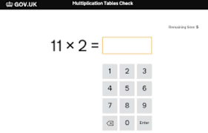
Year 4 – Multiplication Tables Check (MTC)
By the Summer Term of Year 4, children are expected to know all times tables up to 12x12 by heart, in and out of order.
This is really important for them to be able to access the Year 5 and 6 Maths curriculum.
There is a statutory check during June. The results will be reported to parents at the end of the year.
The test is carried out on screen with 25 questions. The whole test should take no more than 5 minutes.

Slide 14
Year 6 – KS2 SATs
These statutory tests take place in May of Year 6 (a few weeks after the Easter break).
English Reading
1 paper, 1 hour
Focus on challenging texts
Pace and stamina required
Precision and clarity in answering written questions
Understanding of vocabulary is key
English Grammar, Punctuation and Spelling
2 papers: 45 minutes on grammar and punctuation and a spelling test (20 words)
Focus on knowing and applying grammatical terms and full range of punctuation
Spelling patterns and methodologies are the basis of the spelling words

Slide 15
Year 6 – KS2 SATs
These statutory tests take place in May of Year 6 (a few weeks after the Easter break).
Mathematics
3 papers: Arithmetic (30 minutes), Reasoning A and Reasoning B (each 40 minutes)
Arithmetic: assesses mathematical calculation competency, including using the formal methods for four operations, fractions, decimals and percentages.
Reasoning: questions in context, multi-step word problems, including shape, space, measure etc in addition to the four operations, and fractions, decimals and percentages.

Slide 16
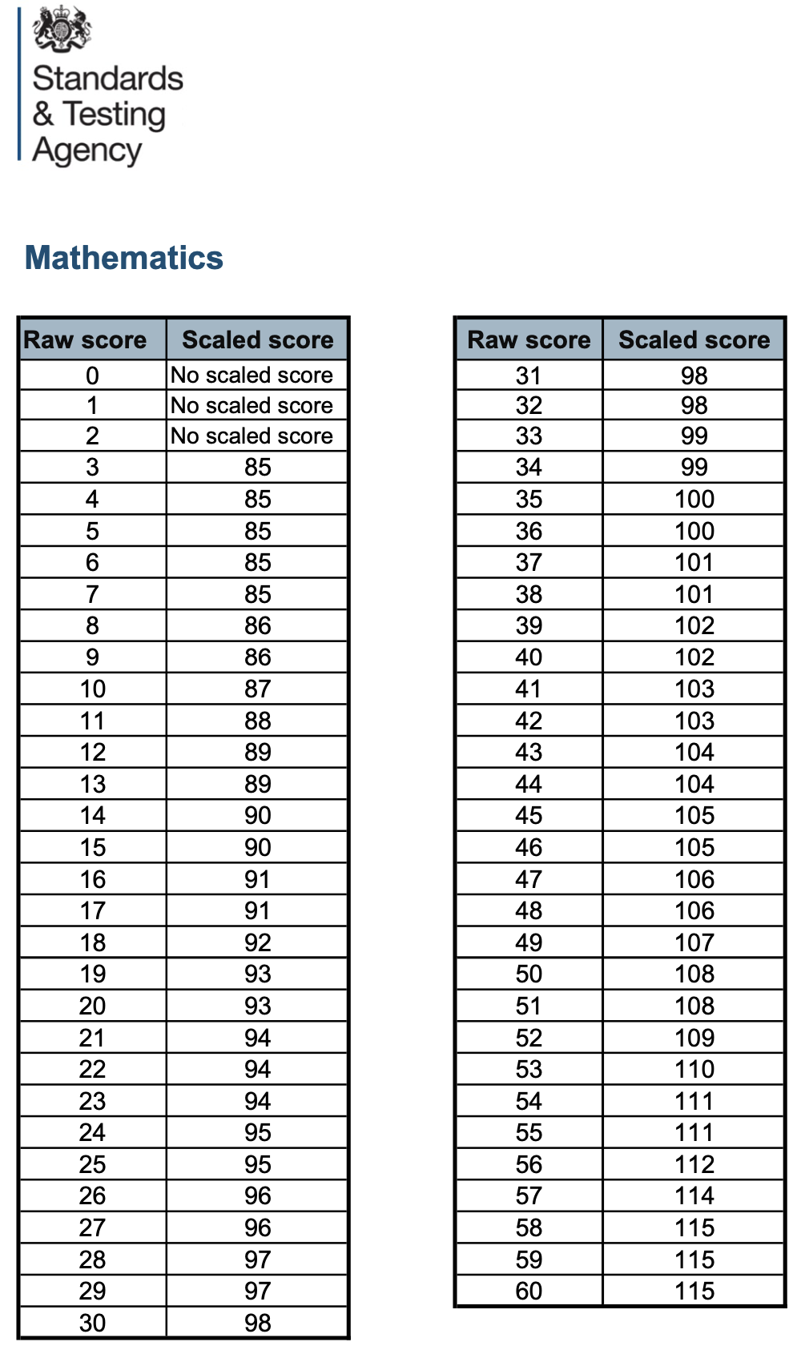
Year 6 – KS2 SATs – Scaled Scored
Tests at the end of KS2 report the results in ‘Scaled Scores’.
Tests at the end of KS2 report the results in ‘Scaled Scores’.
The ‘expected standard’ (ARE) is a scaled score of 100.
Raw scores in the test will be converted into scaled scores. Scaled scores allow comparison year on year.
Children who score 100 or more will have met the expected standard.
Children who score less than 100 will have not met the expected standard.
Children who score 110 or more will have achieved the ’Greater Depth Standard’.

Slide 17

How can you help?
Read with your child and let them see you reading too.
This is just as important once they are a fluent reader.
Talk about the book.
Ask questions and clarify the meaning of new words.
Ask them to explain how they knew something using evidence from the text.
Encourage them to read for sustained periods (15-30 minutes) to build stamina.
Encourage them to read a range of genres.
Top 10 Tips to Encourage Children to Read

Slide 18
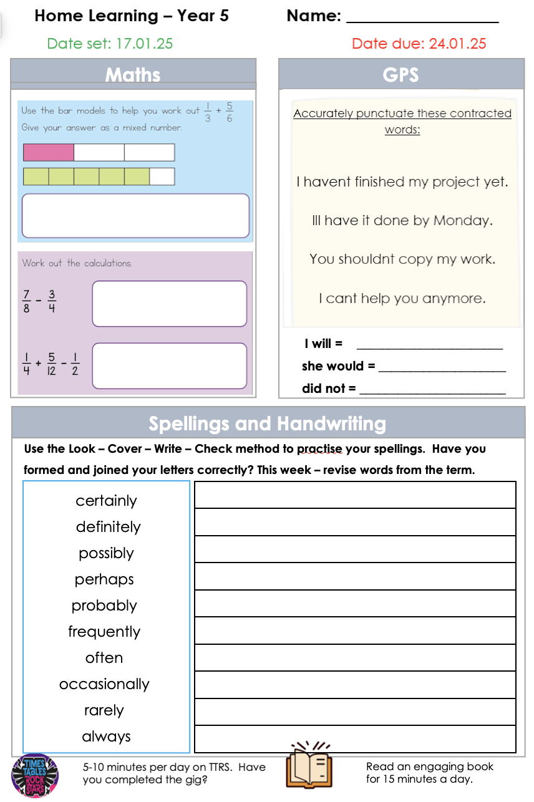

How can you help? Home Learning!
Encourage your child to complete their home learning on time, to hand it in, and to ask their teacher for help if they are not sure.
The home learning is based on what is being taught in class that week (or the week before), so should be achievable for your child.
Help your child to learn their weekly spellings. Writing them out once is not enough to support the learning of spelling rules.
Times Tables Rock Stars –encourage your child to log on to TTRS and improve their scores! Ask your child’s class teacher if you need a reminder of their login.
Build a routine for your child to do their home learning in a calm, quiet space.
Speak positively about school and learning at home.

Slide 19


