Slide 1


Phonics
Information Evening for Parents and Carers
Year 1

Slide 2
Focus of the session:
How we teach phonics at Halstow
– Little Wandle
The Phonics Screening Check
How parents can support children with their phonics learning

Slide 3

Phonics is:
making connections between the sounds of our spoken words and the letters that are used to write them down.
At Halstow, we use the
Little Wandle Program
Notes:
The current scientific research shows that learning to decode words using phonics is an essential element of early reading instruction. The DfE reinforces this, saying: We recognise the weight of research which demonstrates that the most effective way to teach a child to read is a robust programme of systematic synthetic phonics. This is especially the case for younger pupils, and for those struggling with reading.

Slide 4

Phonics Terminology
Phoneme
Grapheme
Digraph
Blend
Trigraph
Split Digraph
Segment
Tricky Words
Notes:
Send out Glossary with slides!

Slide 5


Progression (Content):
Notes:
In Reception, your child learns Phases 2, 3 and 4 (seen on the left).
In Year 1, they will have a brief review of Phases 3 and 4 and all of the Reception tricky words.
By week 4 of the first half term, they will begin phase 5.
Phase 5 covers the last remaining graphemes of the Little Wandle progression and alternative pronunciations and spellings of graphemes learned.

Slide 6

Progression (Teaching):
In Reception children will be taught:
In Year 1 children will be taught:
In Phase 2 (Autumn Term):
Phase 2 grapheme-phoneme correspondences (GPCs)
To blend using the teacher-led approach
To blend and read words with Phase 2 graphemes
In Phase 3 (Spring Term onwards):
The vowel digraphs and trigraphs
To blend and read words with Phase 3 vowel digraphs and trigraphs
To read longer words (‘chunking’)
To ‘blend in your head’ to build fluency
In Phase 5:
New graphemes for the sounds they already know (see Grow the Code mat)
That the same grapheme can have alternative pronunciations
Tricky Words & Spelling
Tricky words are words have irregular spellings like, ‘all’ and ‘people’.
We introduce tricky words systematically across Reception and Year 1 during phonics lessons and practice these throughout each week.
Children also practice spelling words containing the graphemes they have been taught each day
Click icon for Little Wandle
Parents Page
Notes:
In Reception:
Last term we taught your child to blend and read words with Phase 2 graphemes.
In Phase 3 children learn:
the vowel digraphs and trigraphs
to read words containing the Phase 3 digraphs and trigraphs
to read longer words (‘chunking’).
During Phase 2 we taught your child to blend using the teacher-led blending approach.
Now they can start to blend independently.
Children are taught to spot the digraph/trigraph in words first.
In Year 1:
In Phase 5 children learn:
new graphemes for the sounds they already know
that the same grapheme can have alternative pronunciations.
The ‘Grow the code’ lessons support children with reading and spelling these alternative spellings.
Most children will now be confident using the strategy ‘blend in your head’ to build their fluency.
Blending in your head means children say the sounds quietly in their heads and then read the whole word out loud.
If your child is struggling with a word, encourage them to blend in their head.
Children are also taught to spot digraphs in words before reading the word as a whole. This also helps their developing fluency.
Show parents how to spot digraphs in words. Show a word such as ‘head’. Point to ‘ea’ and say: This is a digraph. Model reading the word: h-ea-d head. Show another word e.g. ‘bread’. Ask parents to spot the digraph and read the word: b-r-ea-d bread.
Eventually, reading becomes automatic and children will be able to read words that they know fluently.
Fluency is the ultimate goal of phonics teaching and fluent reading is explicitly taught.

Slide 7
Phonics Screening Check:
All children in Year 1 + Year 2 children who are re-taking
Data is submitted to the DfE and is used only to monitor national trends and inform policy decisions – NOT to track the progress of individual pupils. Individual data is not published.
Results are used in school to gauge progress. However, teachers also use informal assessments each half term to keep track of progress in phonics.
There is a one-week window in June when teachers will administer the check.
Your child will do the PSC 1:1 with their class teacher or a teacher they are familiar with. They will do this in a quiet space away from distractions. Children typically take 5-10 minutes to complete the check. However, teacher will allow children to work at their own pace and take breaks if necessary.

Slide 8
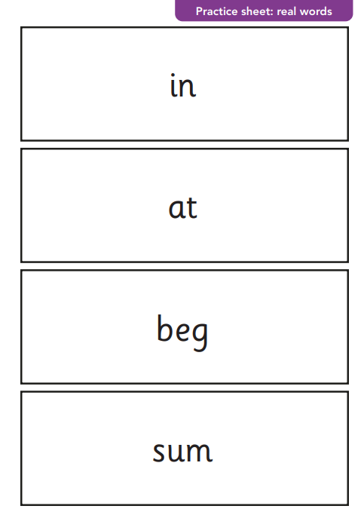
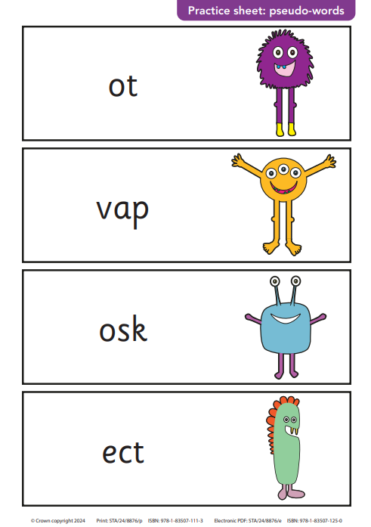
Phonics Screening Check:
Notes:
Children are not required to write anything during the check
They will have a practice before the main check
Teachers cannot point to letters during the check but they can:
- Give instructions and encouragement
Ask the child to ‘have a go’ if they hesitate
All chn to sound out the work aloud before blending

Slide 9


How to support at home:
Daily reading aloud
Read to your child
Encourage reading to themselves in addition
Flashcards
Tricky Words
Spellings
Phonics games
Noticing GPCs when out and about
Alphablocks and other programs
Talking to your child about phonics
Phonics play – handout to follow

Slide 10
How to support at home:
Useful Links:
Information and Resources:
Little Wandle for parents | Letters and Sounds
Phonics screening check (Year 1) - Oxford Owl
Primary Resources - KS2, KS1, Early Years (EYFS) KS3, KS4, Twinkl
Online phonics games:
PhonicsPlay
Letters and Sounds, English Games for 5-7 Years – Topmarks

Slide 11


