Slide 1

Year 6 supporting your child through SATs
Information Evening for Parents and Carers
Year 6

Slide 2
AIMS
SATS timetable
Supporting your child at home
Questions

Slide 3

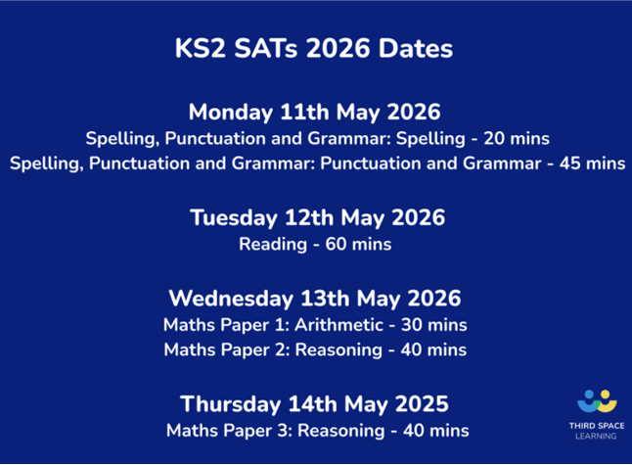

Slide 4
Spelling, Punctuation and Grammar
20-minute spelling test
45-minute Grammar test

Slide 5
Reading Test
One 60-minute test
Three texts

Slide 6
Mathematics
30-minute arithmetic
40-minute
reasoning test
40-minute
reasoning test

Slide 7

Writing is not assessed through the SATs

Slide 8
How can you support your child at home?
Timekeeping
Timekeeping is essential! School opens at 8:50 and the learning starts immediately.
Boosters
Ensure your child attends any booster groups that they have been selected for
Avoid
Avoid making appointments during the school day – especially during SATS week
Encourage
Encourage healthy learning habits and support your child with completing any home learning
Diet
Provide your child with a healthy diet low on sugars, fat and salt.

Slide 9
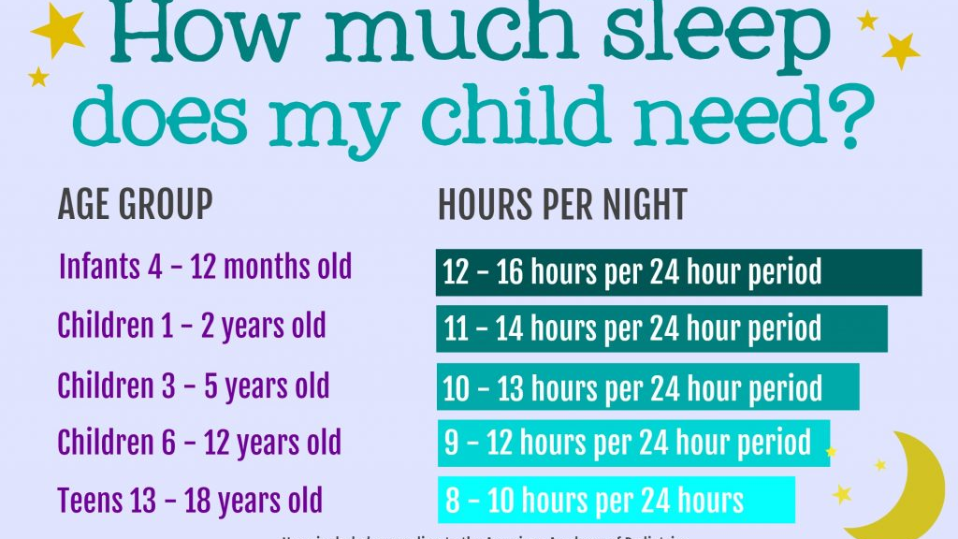
Remove electronic devices and establish a calming bedtime routine to ensure your child is getting enough rest.

Slide 10
Establish routines
TTRS, LbQ and Spellings
Reading
Talk about their learning
Attend boosters if invited
How else can I support at home?

Slide 11
Booster Groups
Precision teaching
Thank you for your support
Attendance is expected – we have chosen the children specifically based on their learning needs.

Slide 12

Questions

