Slide 1

Zones of Regulation
Information Evening for Parents and Carers

Slide 2


What is ‘The ZONES of Regulation’?
● The Zones of Regulation is a complete social-emotional learning curriculum,
created to teach children self-regulation and emotional control.
● Leah Kuypers created the Zones of Regulation concept and published a book. She and her team provide
training and resources for schools.
● We teach it in school as a whole school and in small groups and we feel that
parents can teach and use the zones of regulation at home too.

Slide 3
What is Self-Regulation?
The ability to adjust level of alertness AND direct how emotions are revealed behaviourally in socially adaptive ways in order to achieve goals.
Encompasses:
• Self-control
• Resilience
• Self-management
• Anger management
• Impulse control
• Sensory regulation
(Bronson 2001)

Slide 4
What is Self-Regulation?
Aim of The ZONES of Regulation:
To teach the students to:
• Identify their feelings and levels of alertness
• Effective regulation tools
• When and how to use the tools
• Identifying triggers
• Problem solve positive solutions
• Understand how their behaviours influence others’ thoughts and feelings
And ultimately…
Independent Regulation!

Slide 5
What is Self-Regulation?
Why use The ZONES of Regulation?
• Students who struggle with self-regulation
• Learn to recognise own emotions and controlling impulses
• Can be used with all students including students with a diagnosis of additional needs
• Everyone experiences difficulties with regulation from time to time
• Can be used as a whole school approach- relevant for all year groups
• Can be differentiated for different age groups
• Manage impulses independently without causing disruptions to others
• Assists with social skills and ability to think about others (Kuypers 2011)

Slide 6
What is Self-Regulation?
Why use The ZONES of Regulation?
• Students who struggle with self-regulation
• Learn to recognise own emotions and controlling impulses
• Can be used with all students including students with a diagnosis of additional needs
• Everyone experiences difficulties with regulation from time to time
• Can be used as a whole school approach- relevant for all year groups
• Can be differentiated for different age groups
• Manage impulses independently without causing disruptions to others
• Assists with social skills and ability to think about others (Kuypers 2011)

Slide 7
What is Self-Regulation?
What are the ZONES?? There are four zones to describe how your brain and body feel.
• BLUE Zone – Your body is running slow, such as when you are tired, sick, sad or bored.
• GREEN Zone – Like a green light, you are “good to go.” You body may feel happy, calm and focused.
• YELLOW Zone – This zone describes when you start to loose control, such as when you are frustrated, anxious, worried, silly or surprised. Use caution when you are in this zone.
• RED Zone – This zone is for extreme emotions such as anger, terror and aggression. When you are in this zone, you are out of control, have trouble making good decisions and must STOP!

Slide 8
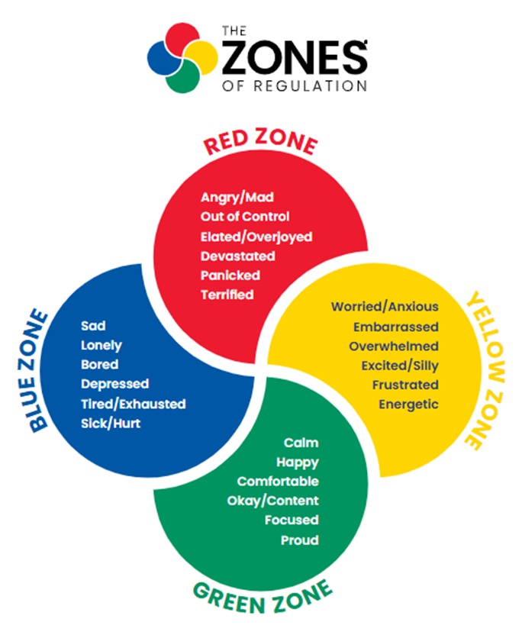
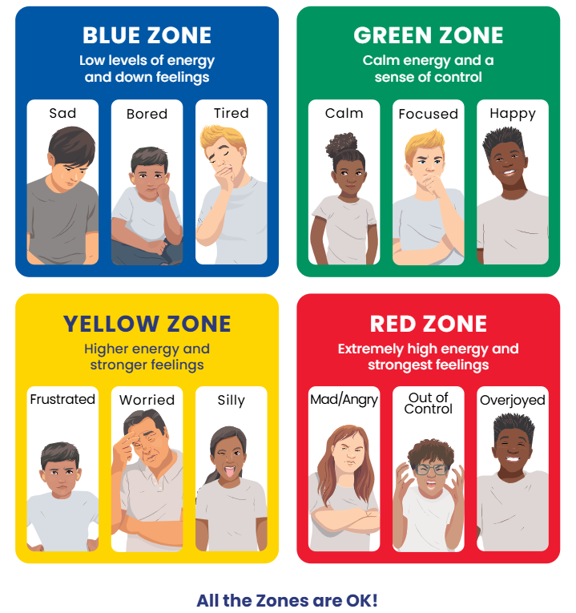
What are the Zones?

Slide 9
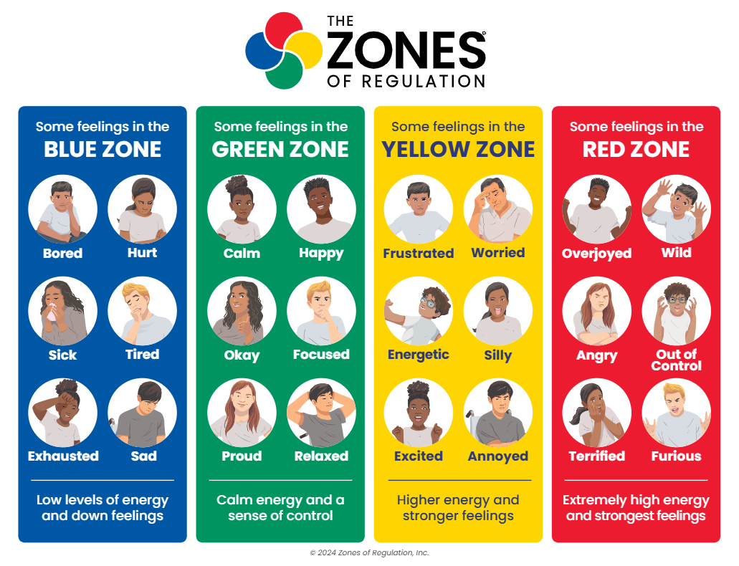
What are the Zones?

Slide 10
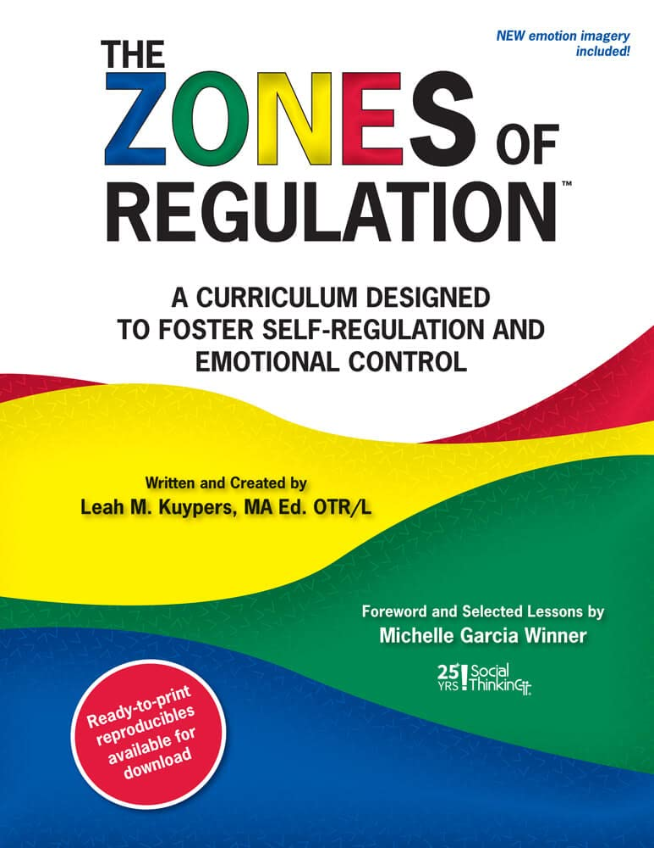
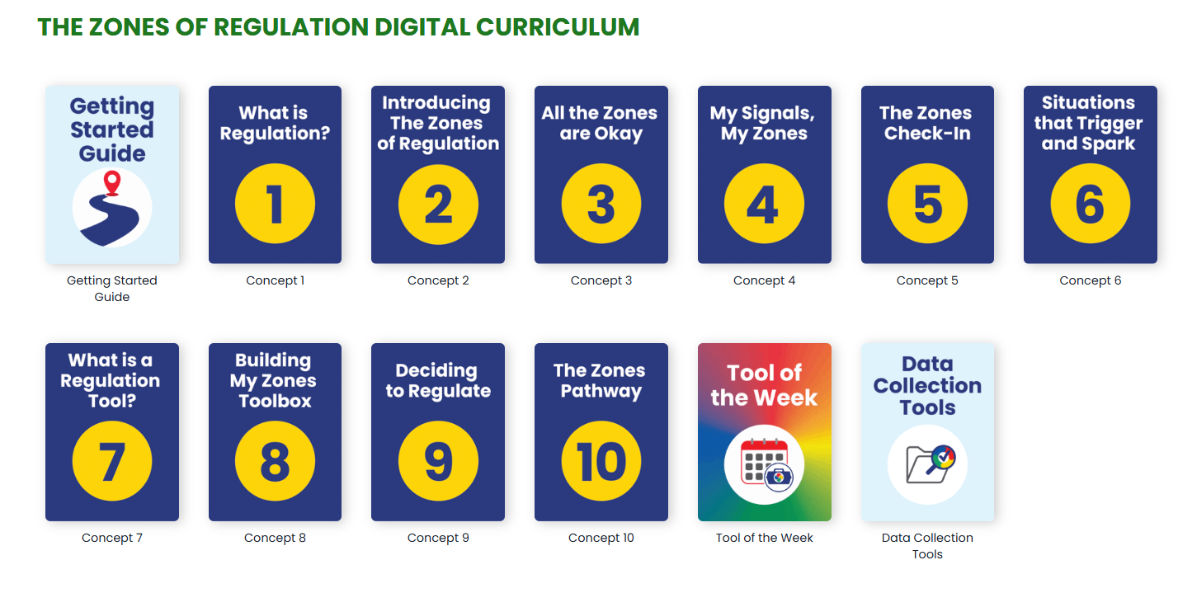
How do we teach this at Halstow?
Reception – Y2
KS2

Slide 11
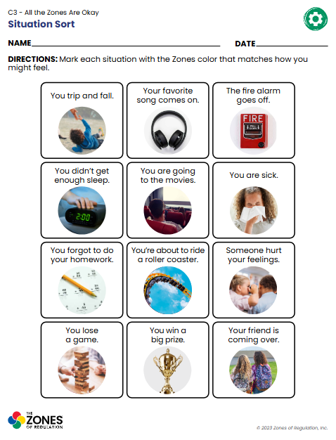
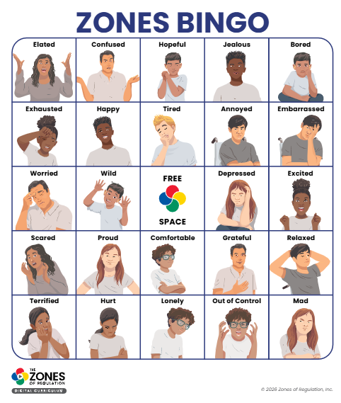
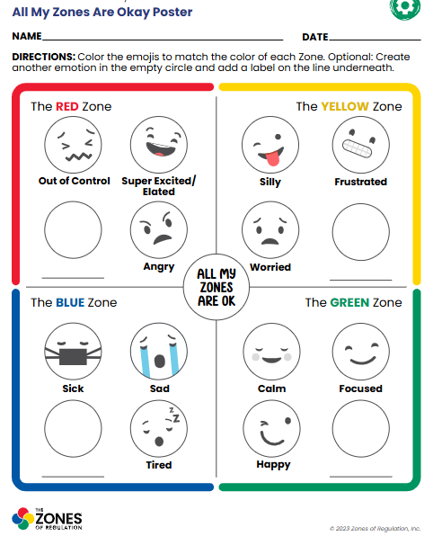
How do we teach this at Halstow?

Slide 12
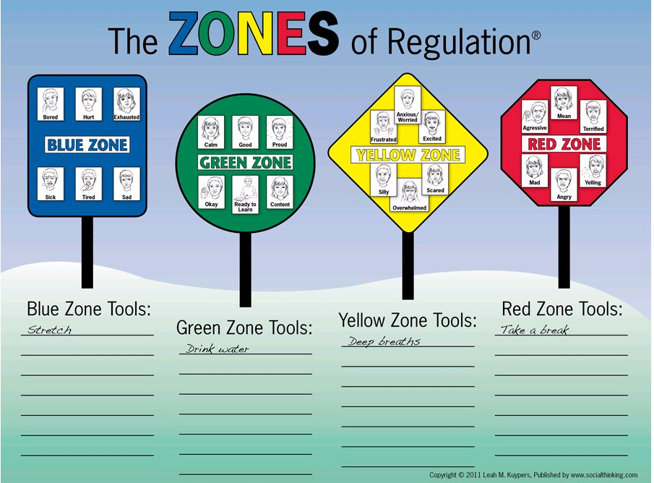
What is Self-Regulation?

Slide 13
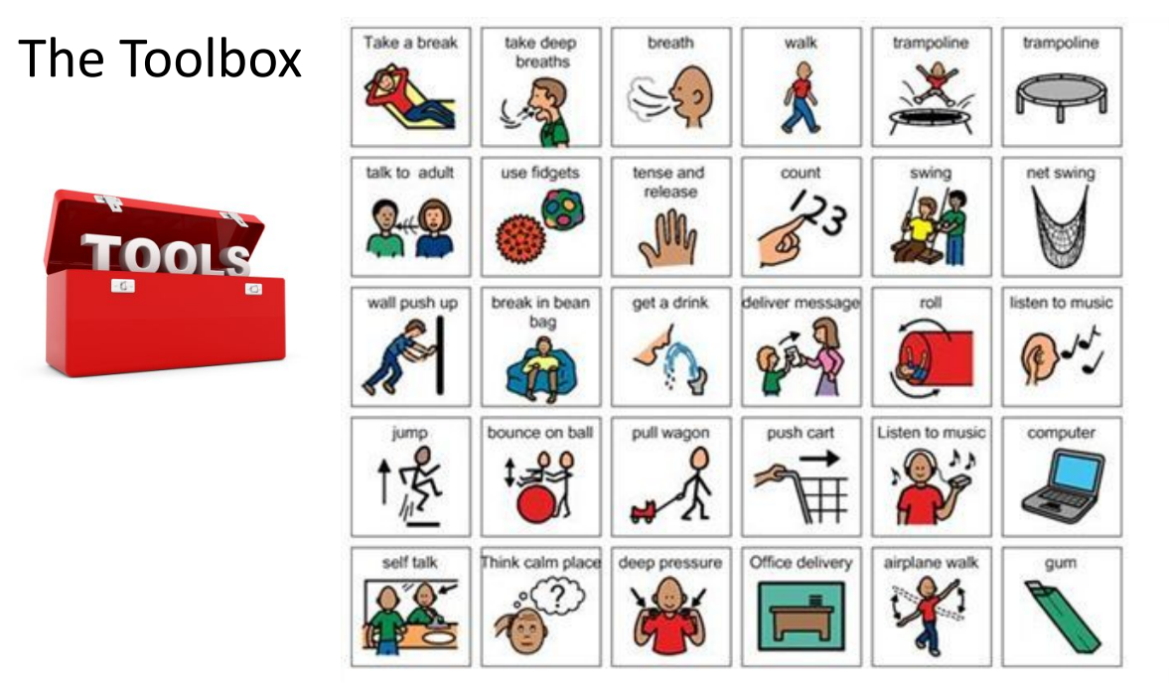
Tools

Slide 14
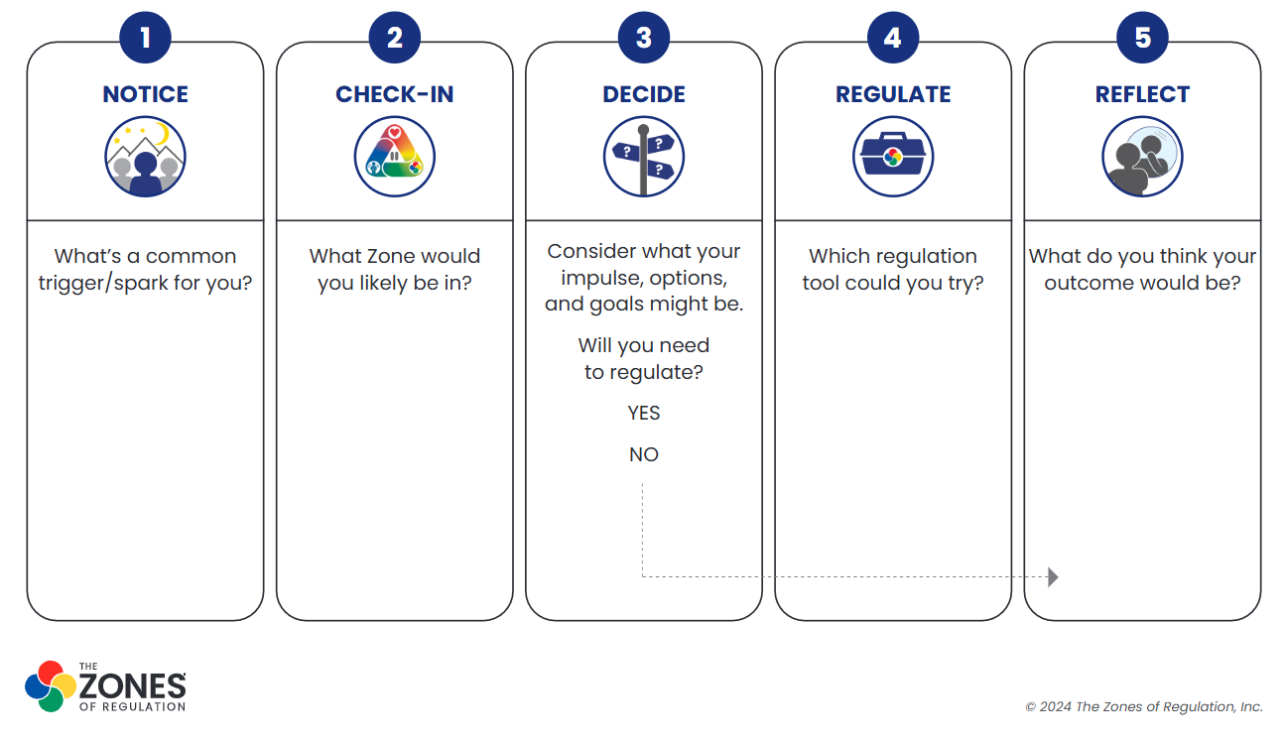
Tools – arriving at Concept 10

Slide 15
What can you do at home?
We would really like for children to be able to continue to practice using their Zones of Regulation to manage their feelings at home.
• Encourage everyone at home to check which Zones they are in across the day – grown-ups included!
• Use the language of Zones to check in with your child ‘I can see you’re in the green zone because you are calm and eating really nicely at the table’. Or when they are getting overexcited/ upset ‘I can see you’re in the yellow zone, let’s use a strategy from the tool box to calm your body down a little’.
• Encourage your children to talk about what strategies they like to use when moving between the zones (eg if they are feeling blue first thing- acknowledge this and discuss what would help them)
• Make a family toolbox full of strategies to move between the zones to use at home and pop it on the fridge to remind you all to use your tools
• Watch the clips in the next slide and talk to your child about the different zones the characters are in and why.

Slide 16
Useful videos to talk through zones
Finding Nemo – turtle scene https://www.youtube.com/watch?v=bVfopcz4nas
Finding Nemo – shark scene https://www.youtube.com/watch?v=XWuPGKLJXe8
Dr Seuss – The Zax https://www.youtube.com/watch?v=dZmZzGxGpSs
Shrek 2 – are we there yet? https://www.youtube.com/watch?v=basofea2UEs
The Incredibles https://www.youtube.com/watch?v=reTz59nkhBw

Slide 17
Useful videos to talk through zones
Further reading: https://www.zonesofregulation.com/index.html

Slide 18

Questions?

